Slide 1
Solving Systems of Equations With examples from economics, chemistry, education and psychology
By: Ernesto Garcia and Rebecca Blitzer

Slide 2
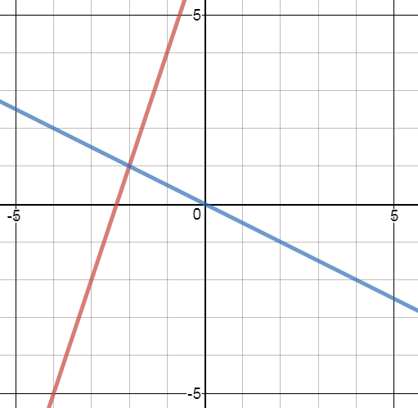

Slide 3
System of equations basics

Slide 4
System of Linear Equations
A system of linear equations is a set of two or more linear equations that share some of the same variables. For example,
$y=3x −2$
$$y=2x$$
or
$2y−5x=1$
$$7y−x=3$$

Slide 5
How to Solve a System of Equations
If you have two equations and two unknown variables, then one of three things will occur:
You will have a unique solution for the unknown variables (the lines represented by the equations intersect).
You will have no solution (the lines represented by the equations do not intersect).
You will have an infinite number of solutions (the lines represented by the equations are the same line).

Slide 6
There are two methods to solve systems of equations: substitution and elimination.
With substitution, we solve one equation for a select variable in terms of the other variable. Then, that select variable is replaced in the other equation giving us an equation with just one variable.
With elimination, we use one equation to eliminate a variable in the other equation which again leaves us with an equation with just one variable.

Slide 7
Question 1
Solve for $x$ and $y$.
$y=−3x+12$ and $y=x+4$.
Solution: We have two equations and two unknowns. To solve, use the fact that both equations are solved for $y$. Set the equations equal to each other and solve for $x$:
$$−3x+12=x+4$$
$−4x+12=4$
$$−4x=−8$$
$$x=2$$
Notes:
X=2 and y=6

Slide 8
This system of two linear equations has one solution hence it must be that these lines intersect each other. The solution will be this intersection point. We know that the value for $x$ will be 2 at this point so we need to find what $y$ is. Since both lines share this point (they intersect at this point), we can plug $x=2$ into either equation and get the (same) value for $y$.
y= -3x + 12 y = x + 4
$y=−3\left(2\right)+12$ $y=2+4$
$$y=−6+12 y=2+4$$
$$y=6 y=6$$
So the solution to this system is $(2, 6)$.

Slide 9
Question 2
Solve for $a$ and $b$.
$$a+3b=−5$$
$$4a−3b=6$$
Solution: It is not immediately obvious how to solve this. We could use substitution by setting $a$ by itself on the left equation or $b$ by itself on the right equation. But let’s try an example using elimination.
$$a+3b=−5 \\ 4a−3b=6$$
When we use elimination, we try to combine the equations through addition so that one of the variables is eliminated. If we combine these equations, the b terms will cancel out leaving us to solve for a.
$$a+3b=−5 \\ 4a−3b=10 \\ 5a=5$$ $a=1$

Slide 10
Substituting for a in an original equation we can then solve for b.
$$a+3b=−5$$
$$1+3b=−5 \\ 3b=−6 \\ b=−2$$
Our solution is a = 1 and b = -2.

Slide 11
Economics example

Slide 12
In economics, there is a concept called “equilibrium” to which all the forces of nature are attracted. For supply and demand, the equilibrium price is a price such that quantity demanded will equal quantity supplied. In other words, the markets clear and there is no excess supply (left over goods) or excess demand (consumers are willing and able to buy the goods in question but are unable to due to unavailability).

Slide 13
Question 3
Suppose demand is defined as $P=12−3Q_{D}$ and supply is defined as $P=Q_{S}+4$. What is the equilibrium quantity?
Solution: Let’s first recognize that in equilibrium: ${ Q}_{D}=Q_{S}$.
Now we have two equations and two unknowns. We notice that both equations have $P$ by itself so set the equations equal to each other and solve for $Q$.
$$12−3Q=Q+4$$
$$−4Q=−8$$
$$Q=2$$
Now plug $Q=2$ into either equation and we will obtain $P$
$$P=2+4$$
$P=6$
Notes:
Q=2 and P=6

Slide 14
Chemistry example

Slide 15
Question 4
How many ounces of a 6% acid solution must be added to how many ounces of a 12% solution to produce 75 ounces of a mixture that is 10% acid?
Solution:
$$x+y=75 \\ 0.06x+0.12y=0.10(75)$$
Using substitution, we get:
$$y=75−x$$
$$0.06x+0.12\left(75−x\right)=7.5$$
$$0.06x+9−0.12x=7.5 \\ −0.06x+9=7.5 \\ −0.06x=−1.5$$ $x=25$

Slide 16
Question 5
Chemical equations an be balanced as in the following example. Beginning with the unbalanced equation
$Ca+H_{3}PO→Ca_{3}P_{2}O_{8}+H_{2}$.
The problem is to determine numbers of molecules of each of the four chemicals so that the equation will be balanced. We want
$$\left(w\right)Ca+{\left(x\right)H}_{3}PO→\left(y\right)Ca_{3}P_{2}O_{8}+{\left(z\right)H}_{2},$$
where w, x ,y, z are numbers of molecules of the respective compounds. (Remember that the subscript shows how many molecules already exist.)
Equating the number of atoms of each elements gives
Calcium: $w=3y$
Hydrogen: $3x=2z$
Phosphorus: $x=2y$
Oxygen: $4x=8y$

Slide 17
Systems of equations are quite useful, as you have just seen.
In the worksheet for this workshop, you get to work out more systems of equations and see more uses of systems of equations.

