Slide 1
Today:
Chap 19 (Vibrations and Waves)
Looking ahead: Midterm 2 Nov 18
(on Chs 9, 11, 13, 14, 15, 19, 20, 22 probably)
Notes:
Tuesday Mar 24

Slide 2
Vibrations
Some Preliminaries
Vibration = oscillation = anything that has a back-and-forth to it
Eg. Draw a pen back and forth over the same line, repeatedly:
When you come back to the same point defines one cycle, one vibration
If do it faster, your “frequency” is higher, your “period” is less.
But your “amplitude” (max. displacement) is the same – it’s bigger if the line is bigger.
(We’ll come back to these terms shortly)
Wave = vibration in both space and time
i.e. goes from one place to another: A vibration that propagates in space

Slide 3
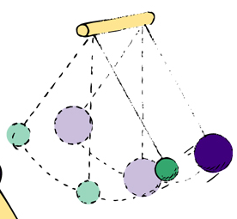
Vibration of a pendulum
Suspend a stone at the end of a string and let it swing to and fro through small distances – makes a simple pendulum.
Very regular oscillations if little friction – eg found in some clocks.
Period = time of a to-and-fro swing (i.e a cycle)
For pendulum, period only depends on its length and g.
The longer the length, the longer the period, i.e. takes more time to come back. i.e. swings less frequently.
Period does not depend on the mass. Quite analogous to the free-fall and inclined planes of Galileo – all masses fall at the same rate in vacuum; also all masses swing back and forth on end of a same-length string at the same rate.
DEMO – swing various objects from a string; find not mass-dependent but is length-dependent.
Also depends on the value of g e.g. the same pendulum oscillates slower on the moon than on earth

Slide 4
Clicker Question
Is the time required to swing to and fro on a playground swing longer or shorter when you stand rather than sit?
Shorter
Longer
The same
      Answer: A
      When you stand, the pendulum is effectively shorter, because the center of mass of the pendulum (you) is raised and closer to the pivot. So period is less – it takes a shorter time.

Slide 5
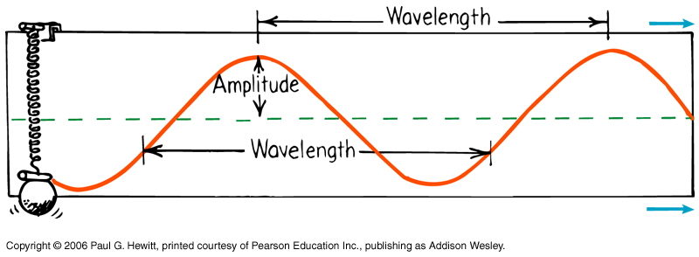
Wave Description
Simple harmonic motion – describes general wave-like motion.
E.g. Hold pendulum bob with ink at the end over a conveyer belt, it traces out a sine wave:
crests (high points)
(shown here is spring but same principle…)
equilibrium
(middle)
troughs (low points)
So: Amplitude = maximum displacement from equilibrium (i.e. to crest or to trough), related to the wave’s energy
Wavelength = crest-to-crest distance, or, distance btn any successive identical parts

Slide 6
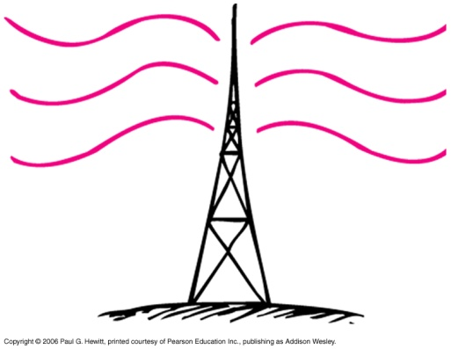
Wave description cont.
Frequency = the number of to-and-fro vibrations in a given time (usually in a second).
One vibration per second = 1 Hertz (Hz) = 1 /s
unit of frequency
Eg. Vibrating electrons are the source of radio waves
Electrons in this antenna vibrate 940 000 times per second – i.e. at 940 kHz. This is the freq of the radio waves produced.
AM radio waves are in kilohertz (kHz =1000Hz), while FM are in megahertz (MHz = 10⁶ Hz).
Microwaves oscillate at gigahertz (GHz = 10⁹ Hz)
Period and frequency are just inverses of each other:
Period = 1/frequency Frequency = 1/Period
Eg. If something makes four vibrations a second, its freq is 4 Hz. It takes ¼ s to complete one vib, so its period is ¼ s

Slide 7
Clicker Question
A weight suspended from a spring is seen to bob up and down over a distance of 20 cm, twice each second. What is its frequency? Its period? Its amplitude?
Frequency 0.5Hz, Period 2s, Amplitude 20cm
Frequency 0.5 Hz, Period 2s,Amplitude 10cm
Frequency 2Hz, Period 0.5s, Amplitude 10cm
Frequency 2Hz, Period 0.5s, Amplitude 20cm
Frequency 2Hz, Period 2s, Amplitude 10cm
Answer C: Frequency = 2 per second = 2 Hz
Period = 1/frequency = ½ s
Amplitude = distance from equil to max displacement i.e. ½ the peak-to-peak distance, i.e. 10cm

Slide 8
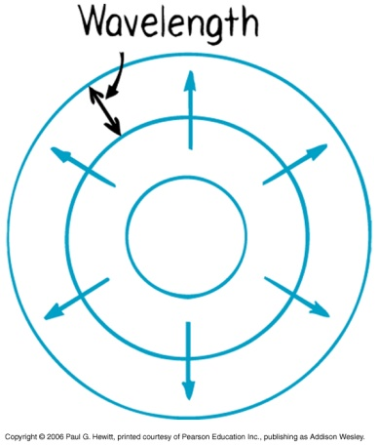
Wave motion
Key point is that the medium (matter that wave is in) does not get propagated as the wave moves; rather, it is the disturbance that propagates
Eg. DEMO: Take a horizontal rope, with bright marker tied at one point. Shake it back and forth to generate a wave – notice the disturbance propagates down rope, but the marker just moves back and forth. Finally, all points return to original position: The disturbance, not the medium, has travelled along.
E.g. Water wave: drop stone in a pond → expanding circles:
Water is not transported with the circles – rather, at any point, it moves up and down as wave passes by. Can see this with a leaf on water’s surface – it just bobs up and down.
Again, medium returns to where it started after wave went by.
Via waves, energy can be transferred from a source to a receiver without the transfer of matter between the two points (eg light waves, sound waves, microwaves…) The larger the amplitude, the more the energy in the wave.

Slide 9
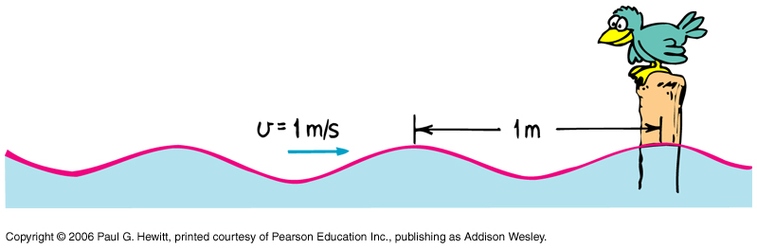
Wave speed
Since speed = distance/time, can sit at a fixed point, measure distance between two crests (i.e. wavelength) and divide by how much time passes between arrival of subsequent crests (i.e. period):
Bird measures time between crests to be 1s.
Hence, wave speed = wavelength/period = wavelength x frequency.
Holds for all types of periodic wave motion (water waves, sound, light…)
Wave speed is a property of the type of wave and the medium, e.g. different water waves may have different wavelengths and periods but all have same wave speed in water.
We often express this as v = f λ

Slide 10
Question
If a water wave oscillates up and down two times each second, and distance between crests is 3 m, what is its frequency, wavelength, and speed?
Frequency = 2 Hz, Wavelength = 3 m, Speed = 6 m/s

Slide 11
Clicker Question
A mosquito flaps its wings 600 vibrations per second which produces the annoying 600-Hz buzz. How far does the sound travel between wing beats? i.e. calculate the wavelength of the mosquito’s sound.
Assume the speed of sound is 340 m/s.
600 m
340 m
C) 340 x 600 m = 204 km
D) (340/600) m = 57cm
E) (600/340) m = 1.76m
Answer: D
speed = wavelength x frequency, so wavelength = speed/frequency
= (340 m/s)/(600 Hz) = 0.57 m, or 57cm

Slide 12
Clicker Question
Some of a wave's energy dissipates as heat. In time, this will reduce the wave's
A) speed.
B) wavelength.
C) amplitude.
D) frequency.
E) period.
Answer: C
The amplitude reflects the wave’s energy…

Slide 13
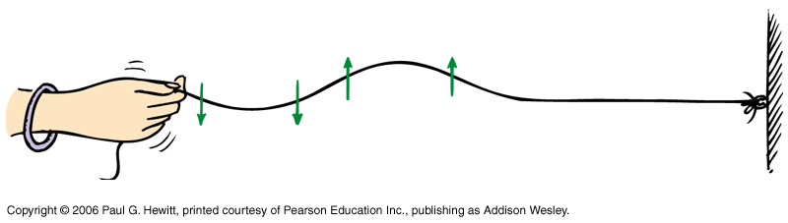
Transverse Waves
When medium particles move at right angles to the direction of the disturbance.
Eg. Waves on a rope generated by shaking back and forth:
Can see this from watching the marker on the earlier demo. Or watching a leaf on the water’s surface as a water wave passes – it goes up and down whereas wave is moving radially outward.
Transverse waves include: water waves, waves on a stringed musical instrument, light, radio waves, microwaves…

Slide 14
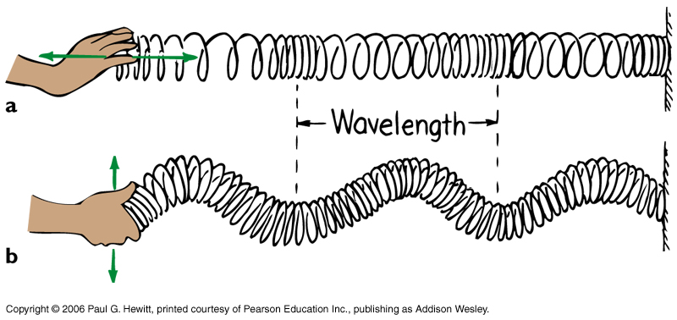
Longitudinal Waves
When medium vibrates in the same direction as direction of wave travel.
Eg. Slinky – when push and pull the end away and towards you:
Medium vibrates parallel to direction of wave and energy flow. It’s a compression wave – distance between compressed regions is wavelength (or distance between stretched regions)
called rarefaction
( Note that a slinky also can produce transverse waves. Shake end like:
Longitudinal waves include: sound waves. Air molecs vibrate to and fro. Can also be thought of as a pressure wave.
Notes:
Bring a slinky

Slide 15
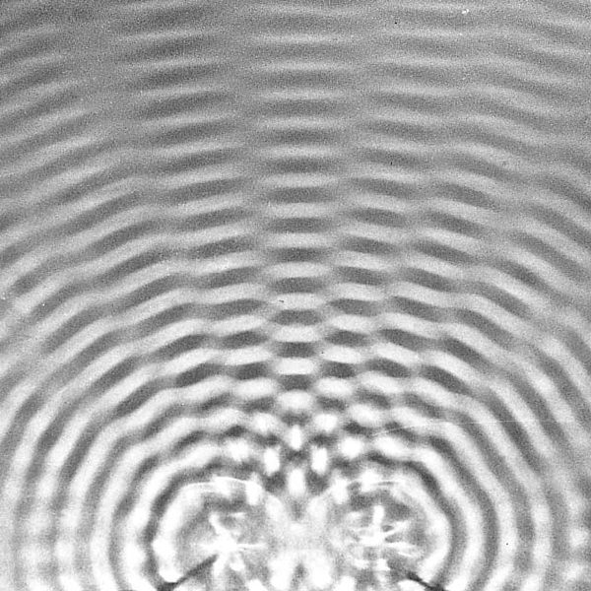
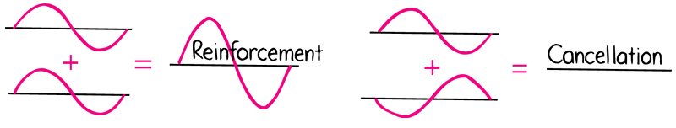
Interference
Property that distinguishes waves from particles: waves can superpose (= overlap), and form an interference pattern, sometimes reinforcing each other, sometimes cancelling each other:
Eg. Water waves – created by two vibrating sources
“grey” lines – out of phase
When a crest of one wave meets a crest of another, they reinforce – “in phase”.
When crest of one meets trough of other, they cancel out - “out of phase”
increased amplitude, constructive interference
decreased amplitude, destructive interference
Superposition principle: at every point, displacements add

Slide 16
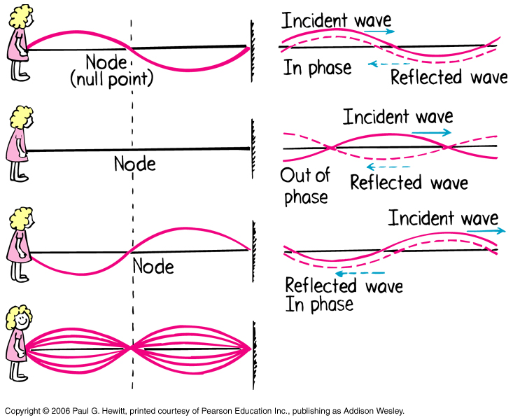
Standing waves
When forward and backward going waves interfere such that parts of the medium are always stationary.
Eg. Tie rope to a wall and shake. Wave going to wall gets completely reflected. Shake in such a way that set up a standing wave:
Node = point of zero displacement
Antinode = regions of max disp. Are halfway between nodes.

Slide 17
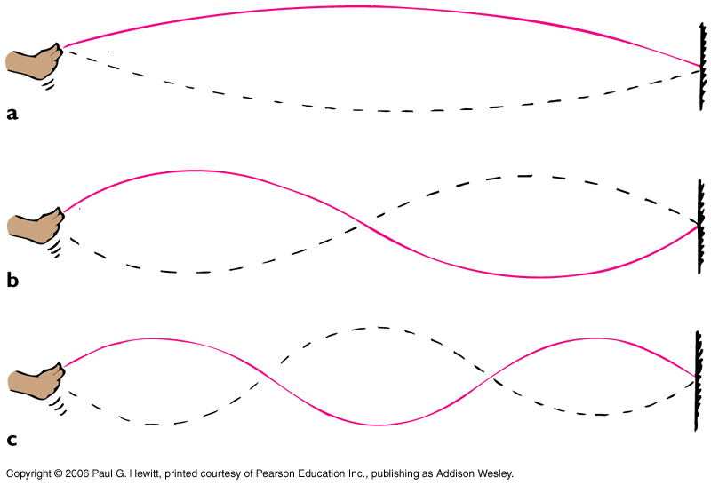
Standing wave DEMO:
Tie one end to wall, and shake at right frequency to get (a).
Then shake twice as fast, and get (b). Three times as fast, get (c).
Rope length = ½ wavelength
1 wavelength and 2 x freq of (a)
1 ½ wavelengths and 3 x freq of (a)
See also hands-on simulations at:
https://phet.colorado.edu/sims/wave-on-a-string/wave-on-a-string_en.html
Musical Instruments: work due to standing waves in string, or in air in a pipe in wind instrument. Can determine pitch from length of string, or of air column…
Notes:
Bring Jumprope

Slide 18
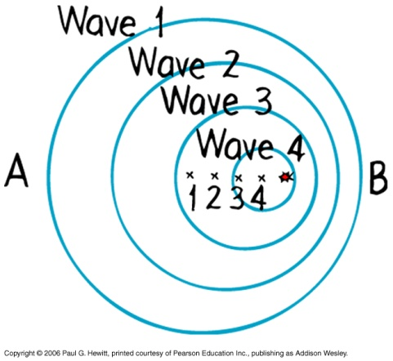
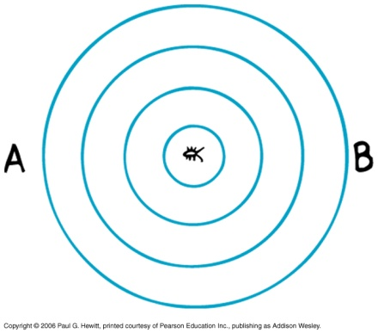
Doppler Effect
is when the frequency changes due to motion of the wave source or the receiver
Why?
Consider first stationary source (e.g. bug treading water with bobbing feet) : waves are circular because distance between crests (wavelength) is same in all directions.
Now consider if bug moves to the right at speed < wave speed. Centers of the circular waves move in direction of bug’s motion.
Snapshot at a fixed time.
Effect is that crests bunch at point B, spread out at point A. Since bug maintains same bobbing frequency, then point B sees waves coming more frequently i.e. B observes higher frequency and shorter wavelength. Similarly, A observes lower frequency and longer wavelength.

Slide 19
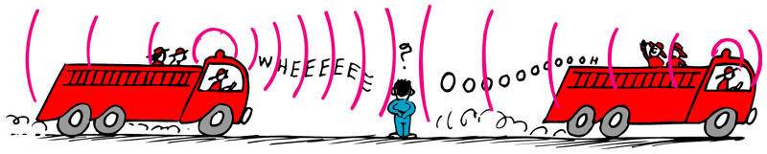
Doppler cont
Nice animation of this at:
http://highered.mheducation.com/olcweb/cgi/pluginpop.cgi?it=swf::800::600::/sites/dl/free/0072482621/78778/Doppler_Nav.swf::Doppler+Shift+Interactive
Doppler effect is why a siren or horn of a car has a higher-than-normal pitch as it approaches you, and a lower-than-normal pitch as it leaves you:
Police speed radar operate on the Doppler effect! (see next chap for more)
Note: don’t confuse pitch(=frequency) with loudness(=amplitude)
Also happens with light – where color is related to frequency, with high frequency being towards blue and low frequency is at the red end of spectrum
Hence, get “blue shift” of an approaching source (freq shifted up); and “red shift” of receding source (freq shifted down).
Eg. Distant galaxies show red shift
Eg. Spinning stars – can measure rate by comparing red shift of when it is turning away from us c.f. blue shift of when it turns towards us.
Notes:
Check online demo

Slide 20
Clicker Question
When an ambulance with its siren on passes you, what quantities do you measure a change in: Frequency, Wavelength, Wave speed, Amplitude?
All of the above
Frequency only
Frequency and wavelength only
Frequency and wavelength, and, eventually, amplitude
Some other combination
Answer: D
Frequency (pitch) and wavelength.
Wave speed stays the same
Amplitude (loudness) eventually decreases

Slide 21
Clicker Question
Is there a Doppler effect when you (the receiver) are moving in a car at the same speed and direction as a honking car?
Yes
No
Sometimes
  Answer B:
  No – no relative velocity between source and receiver.

Slide 22
Question
  Is there a Doppler effect when the source of sound is stationary, and instead the listener is moving? If so, in what direction should listener move to hear a higher frequency?
  Yes, there is a shift in frequency, because there is relative motion between the source and receiver. If you move toward a stationary sound source, you meet wave crests more frequently, so receive a higher frequency.

Slide 23
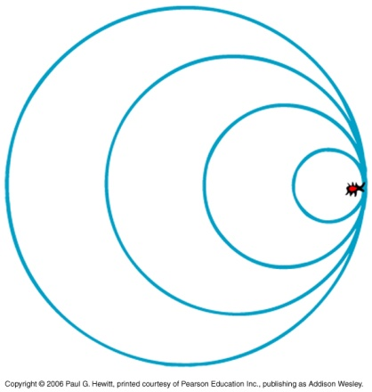
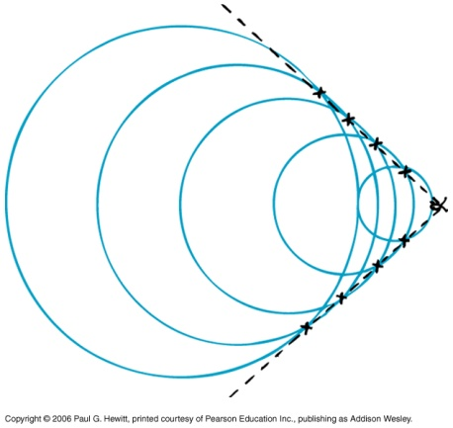
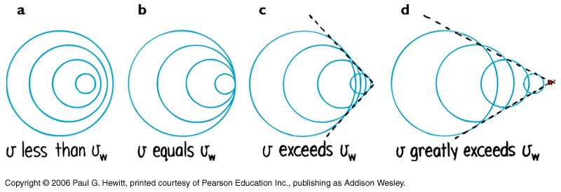
Bow waves
When speed of source is as fast as wave speed, waves pile up: instead of moving ahead of source, they superpose on top right in front.
Now, if source moves faster than wave speed, waves overlap at the edges as shown: Overlapping circles form a V
Called a bow wave eg can see when a boat speeds through water.
Nice animations of these various Doppler phenomena at:
http://en.wikipedia.org/wiki/Doppler_effect
V becomes narrower as source speed increases.

Slide 24
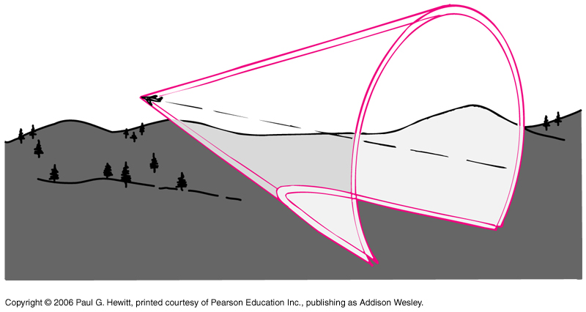
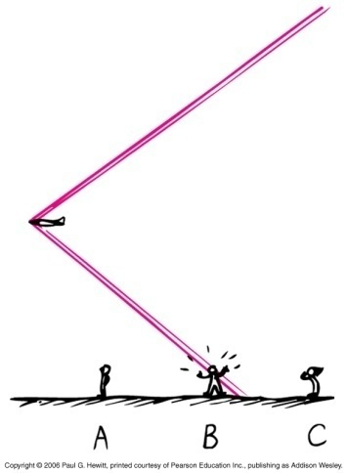
Shock Waves
Essentially is a bow wave in 3-dimensions: the overlapping spheres form a cone.
A supersonic aircraft moves faster than speed of sound – so generates a shock sound wave.
An observer hears a sonic boom (sharp crack like sound) when the shell reaches him – from superposition of crests.
Observer A and C hear nothing. Observer B is now hearing the sonic boom that C has already heard, and that A has not yet heard.
Similarly, get a “water boom” from bow waves; eg a duck can be doused when the bow wave goes by.

Slide 25
Shock waves cont.
Speed of sound ~ 340 m/s ~ 1245 km/h at sea-level
We only hear a sonic boom with supersonic aircraft, not with subsonic – in the latter, sound waves continuously reach ear, no big overlap of crests.
Only when craft moves faster than sound do the waves reach listener in one big burst.
Note a common misconception is that sonic boom is heard just at the moment the craft reaches “sound barrier”- not true! It has likely been traveling supersonically for a while, with its shock wave passing other listeners (c.f. previous picture)
Other examples of sonic booms: crack of a whip (tail of whip travelling faster than speed of sound), supersonic bullet…

