Slide 1
Today:
Finish Ch 19
Start Sound Ch 20
Looking ahead:
Nov 18th is 2nd midterm: Chs. 9, 11, 13, 14, 15, 19, 20, 22
(probably)

Slide 2
Preliminaries
What is the origin of sound?
Vibrations of objects, e.g. of a string, of a reed, of vocal cords..
Usually the small vibration stimulates vibration of a larger object e.g. of the air, that then propagates through surroundings in form of longitudinal waves.
Usually frequency of original vibration = frequency of sound waves = pitch
High pitch means high frequency (e.g. a piccolo), whereas low pitch means low frequency (e.g. fog horn)
Human ear can hear between 20 – 20 000 Hz.
Infrasonic – below 20 Hz
Ultrasonic – above 20 000 Hz

Slide 3
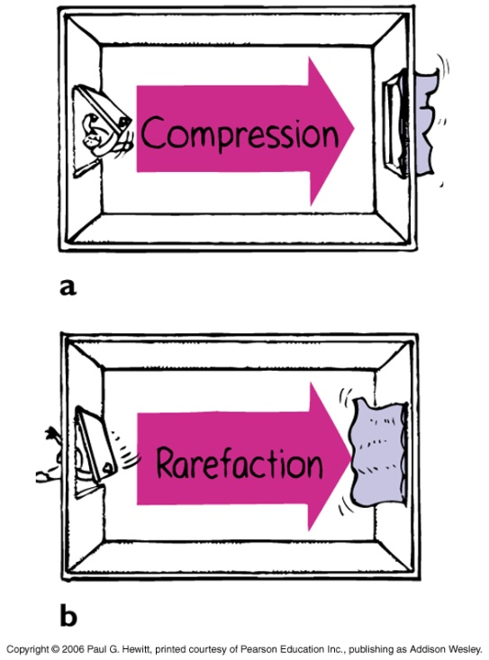
How does sound travel in air?
Longitudinal wave – air molecules vibrate to and fro along direction of wave
Analogy with opening and shutting a door periodically:
Open door inward: a compression travels across room (via molecules pushing neighbors)
Close door: a rarefaction travels across room – some molecs are pushed out of room so leave lower pressure behind.
Swing door open and shut periodically – get periodic compression-rarefaction wave across the room.
Note again: medium (air molecules) are not transported across the room; rather the disturbance, and energy, are.

Slide 4
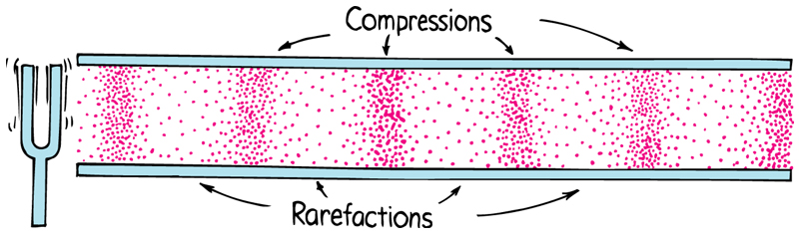
How sound travels in air, continued…
Tuning fork – is exactly this action on a smaller, faster scale: prong vibrating is like the door opening and shutting.
Radio loudspeaker – cone that vibrates in synch with electric signal, causing neighboring air molecules to vibrate …eventually sound wave filling the room
Note: compression and rarefaction travel in the same direction

Slide 5
Clicker Question
Sound waves cannot travel in
A) air.
B) water.
C) steel.
D) a vacuum.
E) any of the above media
Answer: D
Sound is transmitted via periodic compression and rarefaction of the medium – if nothing there, this can’t happen.

Slide 6
Speed of sound in air
In dry air, at 0ºC, speed of sound ~ 330 m/s ~ 1200 km/h
At sea-level and temp, speed ~ 340 m/s
Increased speed if - air is moist
- air is warmer: Speed goes up 0.6 m/s for every ºC
- if wind is blowing from source to receiver
Speed does not depend on loudness (amplitude), nor on pitch (frequency).
Speed of light is a million times as great
- Hence, we see lightning before we hear thunder
- Hence, we see a distant tree fall to the ground before we hear the thud…
Note that low and high pitches all have the same speed – they differ in frequency and wavelength (long for low, short for high), such that the product frequency x wavelength = v is same.

Slide 7
Sound travels in other media too
Doesn’t have to be air – just has to have an elastic property i.e be able to change shape in response to an applied force and then resume its original shape once force is removed.
E.g. putty is not elastic but steel is
Sound generally travels fastest in solids, then in liquids, and slowest in gases
E.g. 15x as fast in steel c.f. air and 4x as fast in water c.f. air
Also, generally less dissipation (ie fading away) in solids and liquids than in air,
E.g. Can hear the slight rattles a distant train makes on the rails before you hear it’s noise from the air
E.g. Motors of boats – sound much louder under water, than above
.
i.e. Liquids and crystalline solids are much better conductors of sound.
Sound needs a medium – won’t travel in a vacuum since nothing to compress and expand

Slide 8
Clicker Question
If you click your fingernails together the sound is significantly louder if you (and your fingers) are under water. Why is this?
Because sound needs a medium to travel in and air is too close to vacuum (i.e. not dense enough)
Because high frequencies dissipate more in air than low frequencies
Because sound dissipates more in air than in liquids
Because the pressure is greater
Answer: C
From previous slides…

Slide 9
Question
Some people claim they have an extra-sensory perception, citing the fact that they awaken from a deep sleep for no reason, get out of bed and walk to the window just in time to hear explosions from a distant munitions plant.
Clairvoyance??
Actually, can explain by comparing the speed of sound through earth and through air! Assume the tremor of the sound wave traveling through earth awoke the person, who then walked to the window just in time to hear the sound wave traveling through the air.
Sound travels through rock at 3000 m/s, and through air at 340 m/s. If the munitions plant is 1 km away, calculate the time interval between the tremor waking the person and him hearing it through the air.
Speed = distance/time, so time = distance/speed.
So time through rock = (1000m)/(3000 m/s) = 0.33 s
Time through air = (1000 m)/(340 m/s) = 2.94 s → time interval = 2.94 -0.33 = 2.6 s

Slide 10
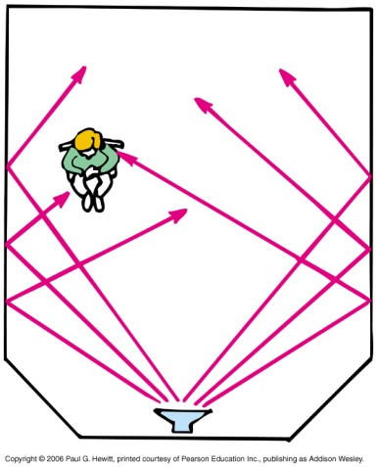
Reflection of Sound
The smoother the surface, the more is reflected, less absorbed
Called an echo
When wave strikes a surface, some is reflected and some is transmitted (i.e. absorbed)
Reflection rule:
Angle of incidence = angle of reflection
(same for light and sound)
Can get multiple reflections - called reverberations – when sound reflects off from one surface onto another and then another…
Causes garbling of sound. Can lessen if surfaces are dampened – i.e. if use material that absorbs more and reflects less. But then also quieter.
Good concert halls need to balance the two effects – study of acoustics.
Sometimes use plastic reflectors above orchestra –if you can see the musician, likely you can hear their music, since same reflection rule.

Slide 11
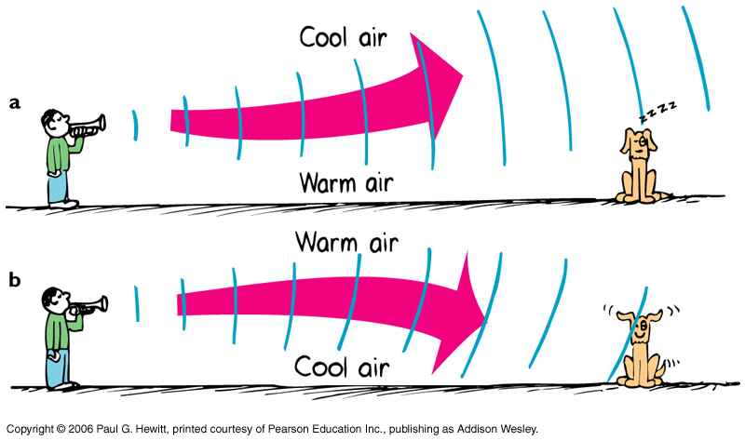
Refraction of sound
Means bending.
Happens when parts of the wave front travel at different speeds eg through windy air or air of varying temperatures:
warm day – air often warmer closer to the ground
Speed of sound is faster in warm air than cold, so effectively bends from warm toward the cool air.
Explains why sometimes we don’t hear thunder from far away lightning – cooler air above, so sound bent away from ground.
cold day or at night, air is colder near ground

Slide 12
More on refraction/reflection…
Refraction happens under water, due to varying water temp – can be problematic for vessels trying to chart sea bottom’s features by bouncing ultrasonic waves off the ground.
But it could be useful for submarines that don’t want to be detected.
Ultrasound procedure in medical diagnosis – ultrasonic waves strongly reflected from outside of organs, so can give a picture of the organs.
- If object is moving (eg a baby’s heart) then the reflected wave is Doppler-shifted; measuring the shift can give baby’s heartbeat, even when foetus is just 10 weeks old!
Dolphins and bats use ultrasound reflection and refraction and Doppler effect to get a sense of their surroundings.

Slide 13
Energy in sound waves
Very small compared to other waves eg. 10 million people talking at the same time produces the same amount of sound energy as that needed to light a common flashlight!
We can only hear because our ears are so sensitive.
As sound travels, sound energy dissipates to thermal.
Higher frequencies dissipate more rapidly than lower frequencies – hence you may hear the boom-boom drums from party music down the street but not the melody…

Slide 14
Clicker Question
A foghorn warns vehicles of hazards or other boats in foggy conditions. Why does it have such a low pitch?
Because low pitches travel faster than high pitches
Because low pitches do not dissipate as quickly as high pitches
Because high frequencies carry farther in air
Because high frequencies travel faster
None of the above
Answer: B
All sound eventually dissipates (gets transformed into heat etc) but low frequencies (= low pitches) dissipate slower than high frequencies.

Slide 15
Forced vibrations
When force an object to vibrate at a certain frequency
Eg. Tuning fork (DEMO): bang and hold in air, sound is quite faint. But if bang it, and then hold on table, get louder sound, because table forced to vibrate too – with its larger surface area, more air molecules forced to vibrate…
Natural Frequency
Characteristic frequency (or frequencies) that an object tends to vibrate at, if disturbed. (But not forced by an external vibrating object)
E.g. Tuning fork, Wine glasses with different amounts of water – characteristic pitch
Determined by elastic properties, shape etc of object – to do with structure. (So only elastic objects have natural freqs – putty does not)
Not just a property of sound waves
Eg Pendulum has a natural frequency determined by its length – if released, will oscillate with that freq. (c.f. last lecture)
Notes:
Bring tuning fork

Slide 16
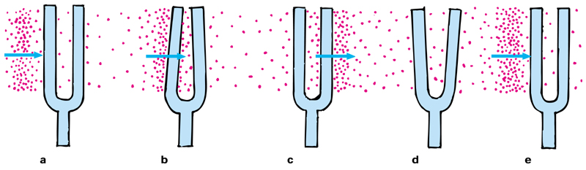
Resonance
Is when frequency of forced vibration = object’s natural frequency
A dramatic increase in amplitude results
Eg. Pumping legs on a swing: pump in rhythm with the swing’s natural freq, and you go higher. Or, someone pushes you at in rhythm with swing - i.e. “in resonance”
Note that if you are pushed really forcefully but not in resonance, you don’t go higher – timing is more important than force.
DEMO: two separated same-frequency tuning forks. Striking one sets the other into vibration! Often called sympathetic vibration.
Here’s what’s happening to the second fork:
1st compression pushes fork in a tiny bit…
Returns at time when another compression arrives – will move out yet further because already moving.
…on return, meets 1st rarefaction, so moves out with greater amplitude – effects of natural freq and wave from 1st fork add.

Slide 17
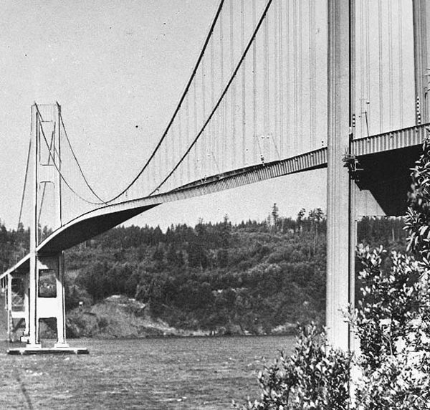
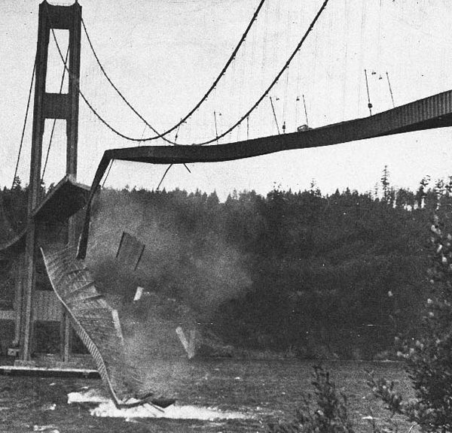
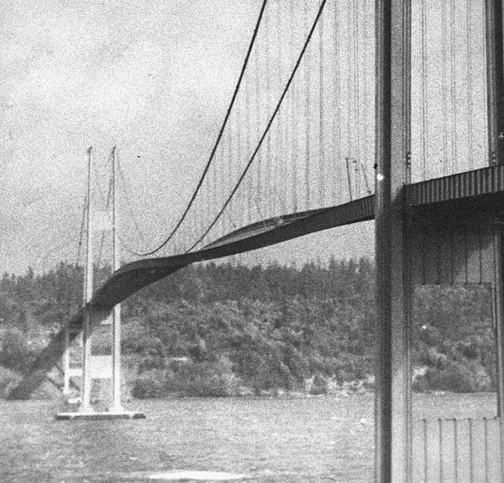
Resonance continued
Note that if the forks did not have matched frequencies, the timing of the pushes with the natural inclination of the second fork will be off; won’t get increased amplitude.
Same principle when tune your radio!
Very important in musical instrument design.
This is why soldiers “break step” when crossing bridges: in 1831, British troops inadvertently marched in resonance (ie in rhythm) with the natural freq of a footbridge, breaking it.
In 1940, this Washington bridge was destroyed by a resonance with wind!

Slide 18
Clicker Question
Caruso is said to have made a crystal chandelier shatter by singing. This is a demonstration of
A) sound refraction.
B) an echo.
C) sound reflection.
D) interference.
E) resonance.
Answer: E

Slide 19
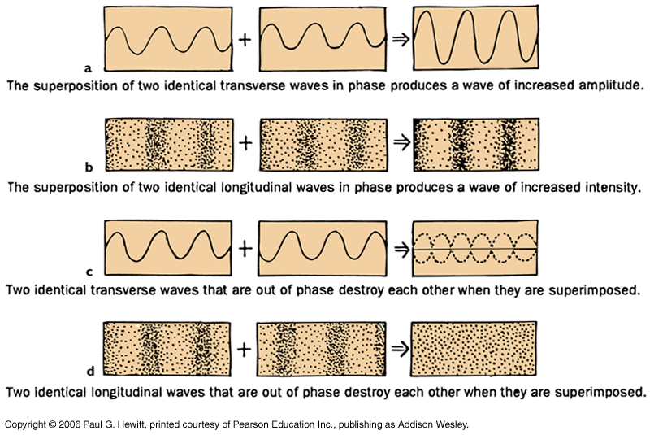
Interference
Recall from Chap 19, but now applied to longitudinal waves too:

Slide 20
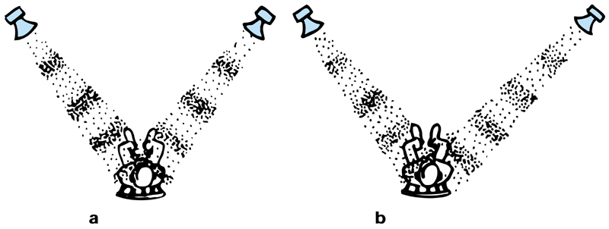
Interference cont.
Consider two speakers driven in synch by same frequency sound:
If sit equi-distant from each, then speakers add, sound is louder (picture a) – constructive interference.
If move a bit to one side, then compression of one meets rarefactions of other, sound is gone (picture b) – destructive interference.
actually, because of reflection from walls etc., you do hear a little sound
Here, path-length difference is half a wavelength
Whether, for certain path-length difference, you get constructive or destructive, depends on the frequency.
Usually speakers emit range of frequencies – only some destructively interfere for a given path-length difference. So usually not a problem, esp. when reflecting surfaces around.

Slide 21
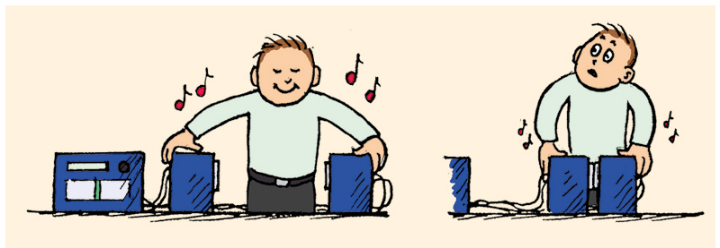
More on interference
Another example you may be able to try at home: Consider driving two speakers with same signal, but switching the + and – inputs on one of them. This makes them out of phase.
Get almost no sound when brought face-to-face - destructive interference as compression regions from one overlap with rarefaction from other.
At very short distances, you can hear very high frequencies – why?
There is a very short path length difference, negligible effect for large wavelength l (low freq), so these destructively interfere. But for high freqs (short l’s) if path-length diff is l/2, then speakers become in phase.
Anti-noise technology – need eg in jackhammers. Electronic microchips produce mirror-image wave patterns of the sound. This is fed to headphones, so to cancel out the loud noise for the operator, while enabling him to still hear co-workers voices!
Notes:
Fix explanation

Slide 22
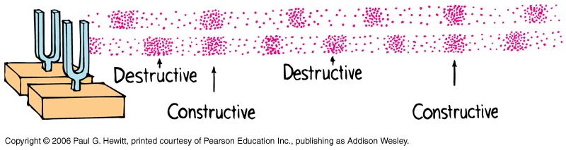
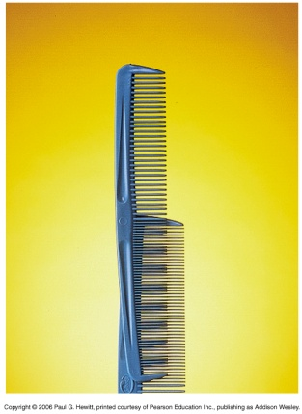
Beats
Are a periodic variation in loudness (amplitude) –throbbing - due to two tones of slightly different frequency.
Arises from interference
Eg. Two slightly mismatched tuning forks – compressions and rarefactions are periodically in step, then out of step:
Eg Analogy with two combs with slightly different teeth spacing:
Number of beats per second = Frequency difference = f₁–f₂
Overall tone (pitch) heard = Frequency average

Slide 23
More on Beats
Nice demo at http://birdglue.com/music-class/beats/index.html
Useful for tuning musical instruments – listen for beats to disappear when freqs of instrument identical to a standard (tuning fork). (See Question shortly)
Beats produced when incident wave interferes with a reflected wave from a moving object: reflected wave has Doppler-shifted frequency, so the two waves differ slightly in freq. Hear beats.
Underlies how police radar in speed-detectors work, since Doppler shift, and therefore the beat frequency, is related to speed of car.
Also underlies how dolphins use beats to sense motions

Slide 24
Clicker Question
A violinist tuning her violin, plays her A-string while sounding a tuning fork at concert-A 440 Hz, and hears 4 beats per second. When she tightens the string (so increasing its freq), the beat frequency increases.
What should she do to tune the string to concert-A, and what was the original untuned freq of her string?
Tighten the string, original freq 436 Hz
Loosen the string, original freq 444 Hz
Tighten the string, original freq either 436 Hz or 444 Hz
Loosen the string, original freq either 436 Hz or 444 Hz
None of the above
Answer: B
Beat freq = 4 Hz, so orig freq is either 444 Hz or 436 Hz.
Increasing freq increases beat freq, so makes the difference with concert-A greater. So orig freq must have been 444 Hz, and she should loosen the string to tune it to concert-A.

Slide 25
Question
A human cannot hear sound at freqs above 20 000 Hz. But if you walk into a room in which two sources are emitting sound waves at 100 kHz and 102 kHz you will hear sound. Why?
You are hearing the (much lower) beat frequency, 2 kHz = 2000 Hz.

Slide 26
Clicker Question
i.e. frequency
Hint: think of what happens to the speed and the wavelength, and deduce frequency from that…

Slide 27
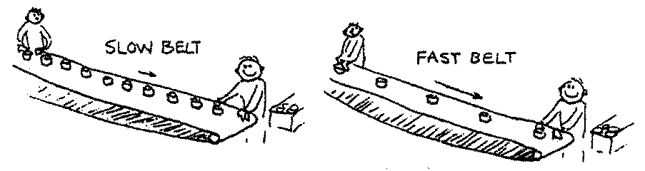
Answer: 2
The wind does not affect the pitch. The wind does affect the speed of sound because the medium that carries the sound moves. But the wavelength of the sound changes accordingly, which results in no change in frequency or pitch. This can be seen by analogy:
Suppose a friend is placing packages on a conveyor belt, say at a “frequency” of one second. Then you, at the other end of the belt, remove one package each second. Suppose the speed of the belt increases while your friend still places one package per second on the belt. Can you see that the packages (farther apart now) will still arrive to you at the rate of one per second?

