Slide 1
Calibrating Your Grading Criteria with a Little Help from Milli Vanilli
Lindsay Portnoy, Educational Foundations

Slide 3
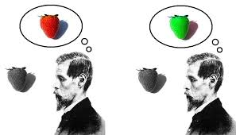
The Problem
How do you objectively evaluate authentic assessments?

Slide 4
Qualitative Work Evaluated Quantitatively
Performance Outcome | Below Standard (1) | Approaching Standard (2) | Meets Standard (3) | Exceeds Standard (4)
Ability provide support for an argument | Does not provide support for argument; does not cite research | Provides minimal support without citing the research | Provides adequate support citing the accompanying research | Provides ample support by extensively citing relevant research and providing rich examples
Performance Outcome
Ability provide support for an argument

Slide 5
Considerations to Address when Creating Rubrics
Validity – Does the rubric measure what it claims to measure.
Reliability – Does the assessment consistently produce the same results.
Transparency – Criteria are clear enough to students so that they can assess themselves and others with roughly the same reliability.
Subjectivity – The amount of judgment used to assign a score to a student’s performance.

Slide 6
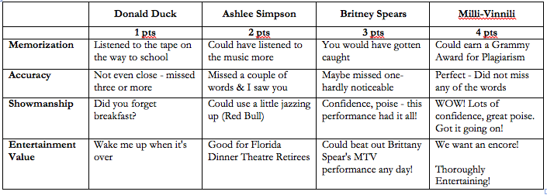
Application to Practice: What Makes a Valid Rubric
Below is the rubric we’ll use to assess the performance of two people in this film

Slide 7
Application to Practice: What Makes a Valid Rubric
P1
P2
P2
P1

Slide 8
Application to Practice: What Makes a Valid Rubric
The film

Slide 9
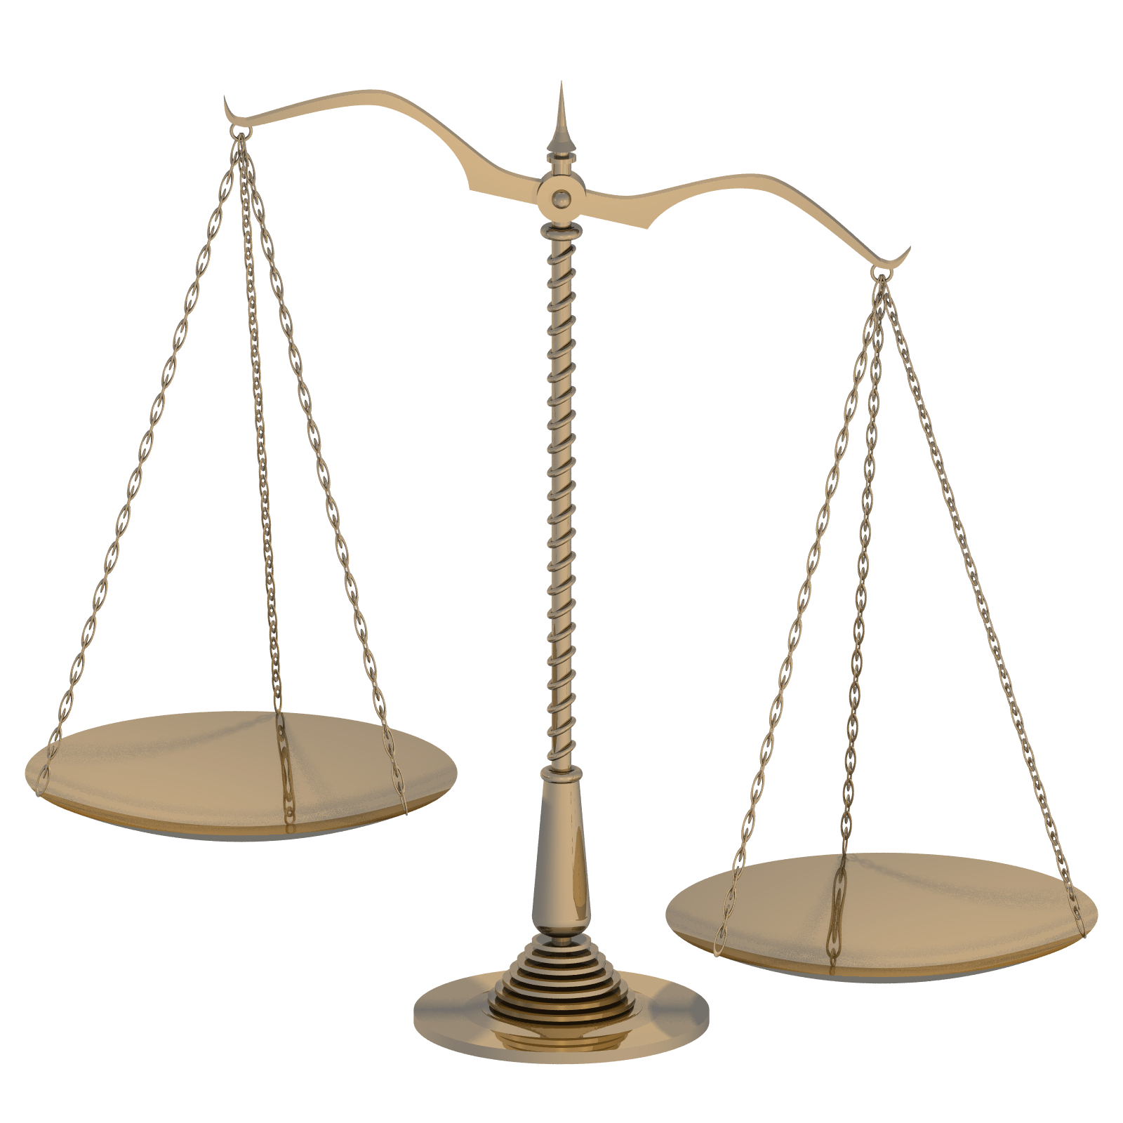
How Valid Was that Rubric?
Memorization
Accuracy
Showmanship
Entertainment Value

Slide 10
Developing Quality Rubrics
1. Do descriptions focus on important aspects of the performance?
2. Does the rating match the purpose?
3. Are the traits directly observable?
4. Are the criteria understandable?
5. Are the traits clearly defined?
6. Is scoring error minimized?
7. Is the scoring system feasible?

Slide 11
Building More Valid Rubrics
Performance Outcome (Descriptor) | Below Standard (1) | Approaching Standard (2) | Meets Standard (3) | Exceeds Standard (4)

Slide 12
Application to Practice: What Makes a Valid Rubric
The film

Slide 13
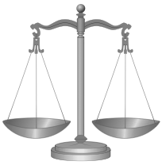
How Valid Was that Rubric?

Slide 14
Who Knew: Errors in Ratings
Carryover effect
Practice improves effort
Effect of extraneous variables
Sloppiness
Halo effect
When it’s better not to know

Slide 15
Who Knew: Errors in Ratings
Rater drift
Less reference to rubric over time
Personal-bias error
Generosity error: everyone’s great
Central tendency error: everyone’s average
Severity error: everyone’s mediocre at best

Slide 16
Rubric Hints and Guidelines
Use samples of student work
Share rubrics with students
Let students create some rubrics
Allow for multiple correct answers

Slide 17
Rubric Hints and Guidelines
Limit the scope of the assessment
Consider the levels of difficulty
Determine the number of levels to develop
Adjust the rubric after, not during the assessment

Slide 18
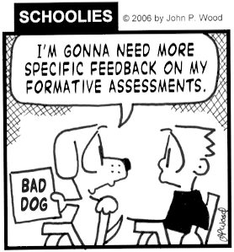
To be formative, the assessment must inform

