Slide 1

Microagressions
Presented by:
John T. Rose
Dean for Diversity and Compliance

Slide 2
Learning Objectives
1. Create awareness surrounding the common occurrences of
microaggresions.
2. Explore the outcomes associated with the experienced on a daily basis on our campus and that community members are likely to experiecne.
3. Discover techniques to minimize the occurrence of microaggressions
4. Consider potential responses when someone has been microaggressive

Slide 3
History
The term “microagression” was coined by Harvard Professor and Psychiatrist, Chester Pierce, in 1970 who is Black. He was studying the persistent presence of stigmatizing representations of Black people in television. He defined it a “subtle, stunning, often automatic and non-verbal exchanges which are ‘put-downs’of Black people
Racial microaggressions are the brief and everyday slights, insults, indignities and denigrating messages sent to people of color sometimes by well-intentioned people who are unaware of the hidden messages being communicated.
-Derald Wing Sue, Columbia University

Slide 4
Definition
Verbal, behavioral, or environmental slights
Often automatic and unintentional
Occur in brief instances on a daily basis
Communicate hostile, derogatory, or negative viewpoints
Perpetuate a worldview of White supremacy and superiority
3 types: micorassault, microinsults, microinvalidations

Slide 5
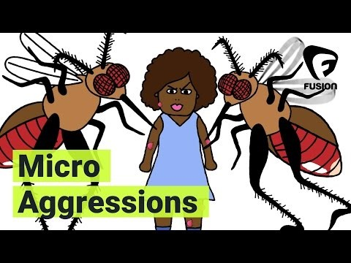
Fusion Video
https://youtu.be/hDd3bzA7450

Slide 6
Microassaults
“Old-fashioned racism”
Uncommon
Deliberate, conscious, and explicit
Intention is to hurt, oppress, or discriminate (Dovidio & Gaertner, 2000)
Examples:
Refusing service to sexual minorities
Displaying the hood of the Ku Klux Klan

Slide 7
Microinsults and Microinvalidations
Not intentional! Typically occur due to underlying biases and prejudices outside of awareness.
Microinsults
  Convey insensitivity, are rude, or demean an individual’s identity or heritage.
Microinvalidations
    Exclude, negate, or nullify an individuals’ thoughts or feelings

Slide 8
Themes of Microagression
Appearance: Looking Different
Ascription of Intelligence
Color Blindness
Denial of individual racism
Pathologizing Cultural Values
Assumptions of Criminality
Myth or Meritocracy
Second Class Citizenship
Religion

Slide 9
Theme | Microaggression | Message
Alien in Own Land | “You speak good English” | You aren’t American
Ascription of intelligence | “You are so articulate” | It is unusual for someone of your race to be so intelligent
Color Blindness | “When I look at you, I do not seen color” | Denies a person’s color or racial heritage
Assumption of criminal status | Following a customer of color around a retail store | You are going to steal
Denial of individual racism /bias | “My best friend is Black” | I am immune because I have friends of color
 | “As a woman, I know what you are going through” | Your racial oppression is no different than my gender oppression
Myth of Meritocracy | Everyone can succeed in America if they work hard enough | People of color are lazy or incompetent and need to work harder
Pathologizing Cultural Values | Dismissing an individual who brings up race/culture at work/school | Leave your cultural baggage outside; you must assimilate
Second Class Status | Taxi Driver passes a person of color to pickup a white passenger | You are likely to cause trouble or to travel to a dangerous neighborhood

Slide 10
Theme | Microagression | Message
Gender | “Smile, you are too pretty for people not to see your smile” | Your appearance defines what people think of you
 | A female doctoral student continues to receive emails addressed as “Dear Sir” | It is unlikely for someone of your gender to be pursuing an advance degree in this field
Sexual Orientation | “ I like you but why do others have to shove it on our face” | The LGBTQ experience is offensive and abnormal
 | “So whose the man in the relationship? | Implies that “normal relationship” must be between between a man and a woman
Disability | Without being asked to a man helps a disabled person board a train | You can’t function independently
Religion | “You don’t look Jewish!” | All Jewish people look the same
Environmental | Television shows/movies without representation of people of color or representation in limited roles A college with all buildings named after white hetero-sexual males | You are an outsider and do not exist and/or only exist to serve those count You do not belong here

Slide 11
Internal Dilemma
Experiencing a microagression may lead to the following intrusive cognitions:
Did I interpret that correctly?
Did she say what I think she said?
What did he mean by that?
Should I say something?
Saying something may make it worse
They’ll probably think I am overreacting
Speaking up is going to hurt more than helps

Slide 12
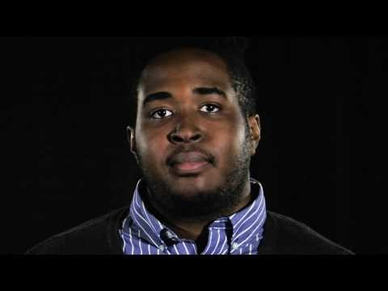
Microagression in the classroom
https://youtu.be/ZahtlxW2CIQ

Slide 13
Impact
“Racial microaggressions create a hostile and invalidating climate for people of color, saps their spiritual and psychic energies, and their cumulative nature can result in depression, frustration, anger, rage, loss of self esteem, anxiety, etc.”
-Derald Wing Sue

Slide 14
Productive Responses
Take a deep breath
Assume offense was not the intent
Explain how the slight may be interpreted by others
As a follow-up question e.g. who are referring to when you say that? What do you mean?
Identify individuals you feel comfortable discussing issue with (e.g. family, friends, cohort member, mentors)

Slide 15
Productive Response…continued
What about when the “perpetrator” denies having been offensive:
Ask yourself:
  o Will further conversation will be beneficial AND productive?
    What is my current level of stress?
  o Am I able to respond non-emotionally?
If you decide to discuss further:
Take a deep breath!
Reiterate that you are not blaming the person, only expressing the way the comment/action made you feel.
Explain that instances occur daily and others have made similar comment/actions.
      Be open to their input and expression of their feelings.

Slide 16
Next steps
Individuals
Recognize that dismissive attitudes are harmful.
Engage in self-reflection to identify times that you may have been microaggressive in your personal and academic life.
Participate in continuing education activities.
Avoid making assumptions and labeling individuals.
Institutions
Foster inclusive and supportive environments.
Collaborate with groups and organizations who are committed to addressing issues of diversity and inclusion.
Offer trainings and opportunities for continuing education and diversity workshop

