Slide 1
DOLCIANI MATH LEARNING CENTER
FALL 2021
PLEASE ENABLE YOUR SOUND!

Slide 2
Things to know
7th floor of the library within the silverstein student success center
General information: dmlc@hunter.cuny.edu
Dmlc bulletinS
Dolciani website: www.hunter.cuny.edu/dolciani

Slide 3
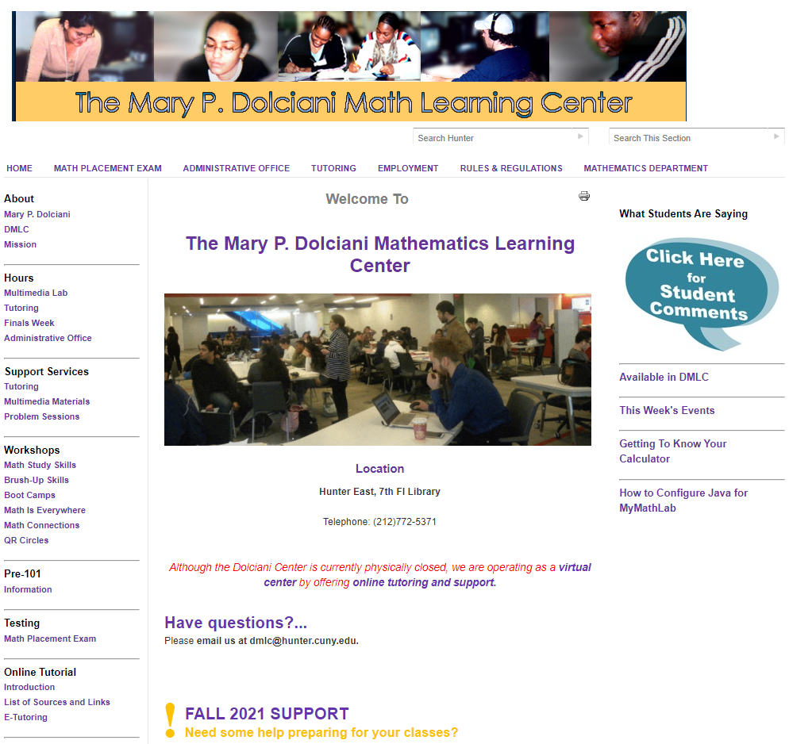
website

Slide 4
Support services
Presentations: learning math in an on-line environment & STUDY AND LEARNING SKILLS FOR ONLINE CLASSES
Brush-up materials: prerequisite skills – model problems - practice
Study skills workshops: seminars – tips for studying and test taking
Multimedia materials: computer tutorials – drill and practice
Tutoring: peer assistance with troublesome topics or guided practice

Slide 5
TUTORING
ONLINE AnD ONSITE
APPOINTMENTS THROUGH NAVIGATE UP TO 10 MINUTES BEFORE THE SESSION BEGINS
APPOINTMENT LINK SENT TO YOU AND ON OUR WEBSITE
45-MINUTE SESSIONS
LIMITED TO 8 STUDENTS
ONLINE THROUGH ZOOM
REGULAR TUTORING BEGINS SEPTEMBER 9
Continuous Evaluations to improve services

Slide 6
USE US!

