Slide 1
Making the Connection Between Linear and Literal Equations with examples from nursing, economics, physics, and everyday life
By: Ernesto Garcia and Rebecca blitzer

Slide 2

Solve for Time: $D=rt$

Slide 3
Equation Basics

Slide 4

What is an Equation?
An equation is a statement saying that the two mathematical expressions on either side of the equal sign (denoted by “=“) are equivalent.
Examples:
$$x+11=18$$
$3=\frac{x+4}{9}$
$\frac{y}{3}+4=1$

Slide 5


How do we solve the previous examples?
$x+11=18$
$$x+11−11=18−11$$
$$x=7$$
$3=\frac{x+4}{9}$
$3∙9=\frac{x+4}{9}∙9$
$$27=x+4$$
$$27−4=x+4−4$$
$$23=x$$
$$\frac{y}{3}+4=1$$
$$\frac{y}{3}+4−4=1−4$$
$$\frac{y}{3}=−3$$
$$\frac{y}{3}∙3=−3∙3$$
$y=−9$

Slide 6
Literal equations

Slide 7
What is a Literal Equation?
A literal equation is an equation where the variables represent known values. Literal equations make life so much easier. The next slide shows some examples of literal equations.

Slide 8

$$\text{Examples}\text{:}$$
  $$I=prt\text{ (}\text{Simple} \text{interest}\text{)}$$
  $$I=\frac{V}{R}\text{ (}\text{Ohm}\text{’}\text{s} \text{law}\text{)}$$
  $$A=lw\text{ (}\text{Area} \text{of} \text{a} \text{rectangle}\text{) }$$
  $$F=ma\text{ (}\text{Second} \text{Law} \text{of} \text{Motion}\text{)}$$
  $$E=mc^{2}\text{ (}\text{Mass}\text{/}\text{Energy} \text{Equivalence}\text{)}$$
  $$F=\frac{9}{5}C+32\text{ (}\text{Fahrenheit}\text{/}\text{Celsius} \text{Equation}\text{)}$$
  $MAP=\frac{\left[\left(2∗diastolic\right)+systolic\right]}{3}$ (MAP=mean arterial pressure)
$V=0.041h−0.018A−2.69$ (Female vitals)
$F=\frac{Gm_{1}m_{2}}{d^{2}}$ (Law of Universal Gravitation)

Slide 9
Solving literal equations

Slide 10
  In order to solve these one must:
  be able to algebraically manipulate the equations that contain letters and variables.
  realize they are not much different from solving plain old linear equations.

Slide 11

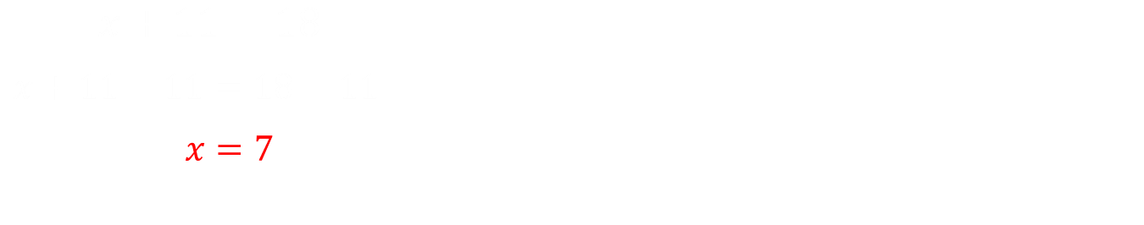


How do we solve our previous examples if they are literal equations? Compare left and right.
$$x+y=18$$
$$x+y−y=18−y$$
$$x=18−y$$
$x+11=18$
$$x+11−11=18−11$$
$$x=7$$
$$3=\frac{x+4}{9}$$
$$3∙9=\frac{x+4}{9}∙9$$
$$27=x+4$$
$$27−4=x+4−4$$
$$23=x$$
$$3=\frac{x+y}{z}$$
$$3∙z=\frac{x+y}{z}∙z$$
$$3z=x+y$$
$$3z−y=x−y$$
$$3z−y=x$$

Slide 12
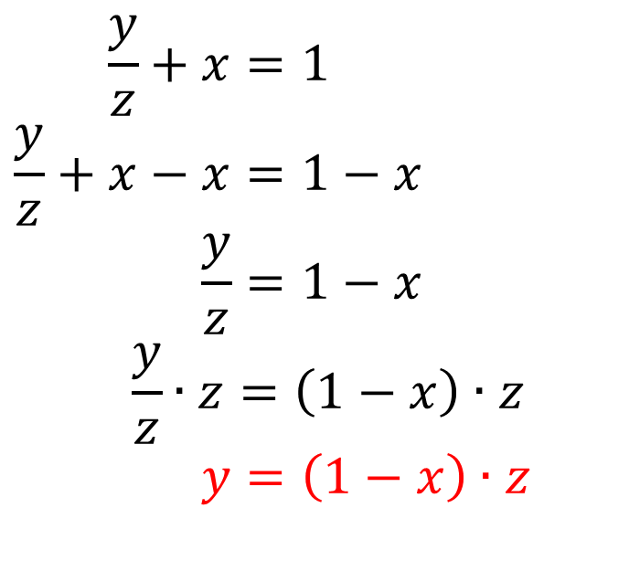
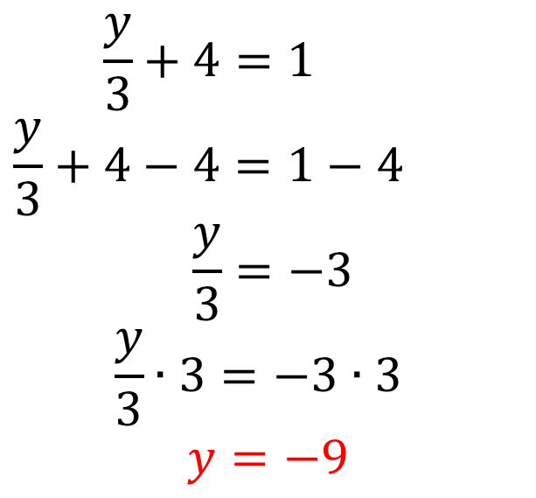
$$\frac{y}{3}+4=1$$
$$\frac{y}{3}+4−4=1−4$$
$$\frac{y}{3}=−3$$
$$\frac{y}{3}∙3=−3∙3$$
$y=−9$
$$\frac{y}{z}+x=1$$
$$\frac{y}{z}+x−x=1−x$$
$$\frac{y}{z}=1−x$$
$$\frac{y}{z}∙z=\left(1−x\right)∙z$$
$$y=\left(1−x\right)∙z$$
Notice how the skills required to solve the equation on the right are the same as the ones needed to solve the equation on the left.

Slide 13
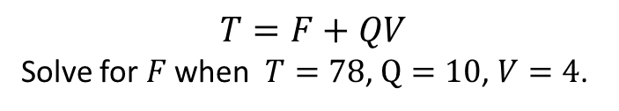
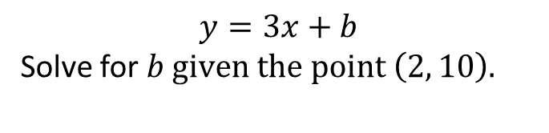
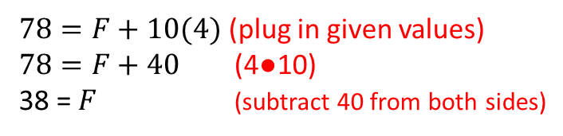
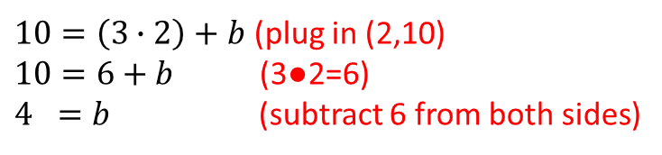
Using Literal Equations in Everyday Life
The equation on the left shows the equation of a line where b is the y-intercept, and x and y represent the values in the ordered pair. The equation on the right is a total-cost formula for factory machine service where T is the total cost, F is a fixed fee, Q is the amount of a service given, and V is the amount of times this service is provided.
$$y=3x+b$$
Solve for $b given the point \left(2, 10\right).$
$$T=F+QV$$
Solve for $F$ when $T=78$, $Q=10$, $V=4$.
$10=\left(3∙2\right)+b$ (plug in (2,10)
$10=6+b$ (3●2=6)
$4 =b$ (subtract 6 from both sides)
$78=F+10(4)$ (plug in given values)
$78=F+40$ (4●10)
38 = $F$ (subtract 40 from both sides)
With practice, you should be able to translate your algebra skills to equations that have more letters and variables than your standard linear equation.

Slide 14
Manipulating Literal Equations
Sometimes, we need to manipulate literal equations to express the relationship between quantities in a different way.

Slide 15

Question 1: Solve $F=\frac{9}{5}C+32$ for $C$.
Solution: This equation is used to convert between Fahrenheit and Celsius. Here we have the equation set up to convert from Celsius into Fahrenheit. Solving for $C$ will flip that to converting Fahrenheit into Celsius.
$$F=\frac{9}{5}C+32$$
$F−32=\frac{9}{5}C+32−32$
$F−32=\frac{9}{5}C$
$\frac{5}{9}∙\left(F−32\right)=\frac{5}{9}∙\frac{9}{5}C$
$\frac{5}{9}∙\left(F−32\right)=C$

Slide 16

Question 2: Solve $3h+g=5h−f$ for $h$.
Solution:
$$3h+g−3h=5h−f−3h$$
$$g=2h−f$$
$$g+f=2h−f+f$$
$g+f=2h$
$\left(g+f\right)∙\frac{1}{2}=2h∙\frac{1}{2}$
$\frac{1}{2}\left(g+f\right)=h$

Slide 17
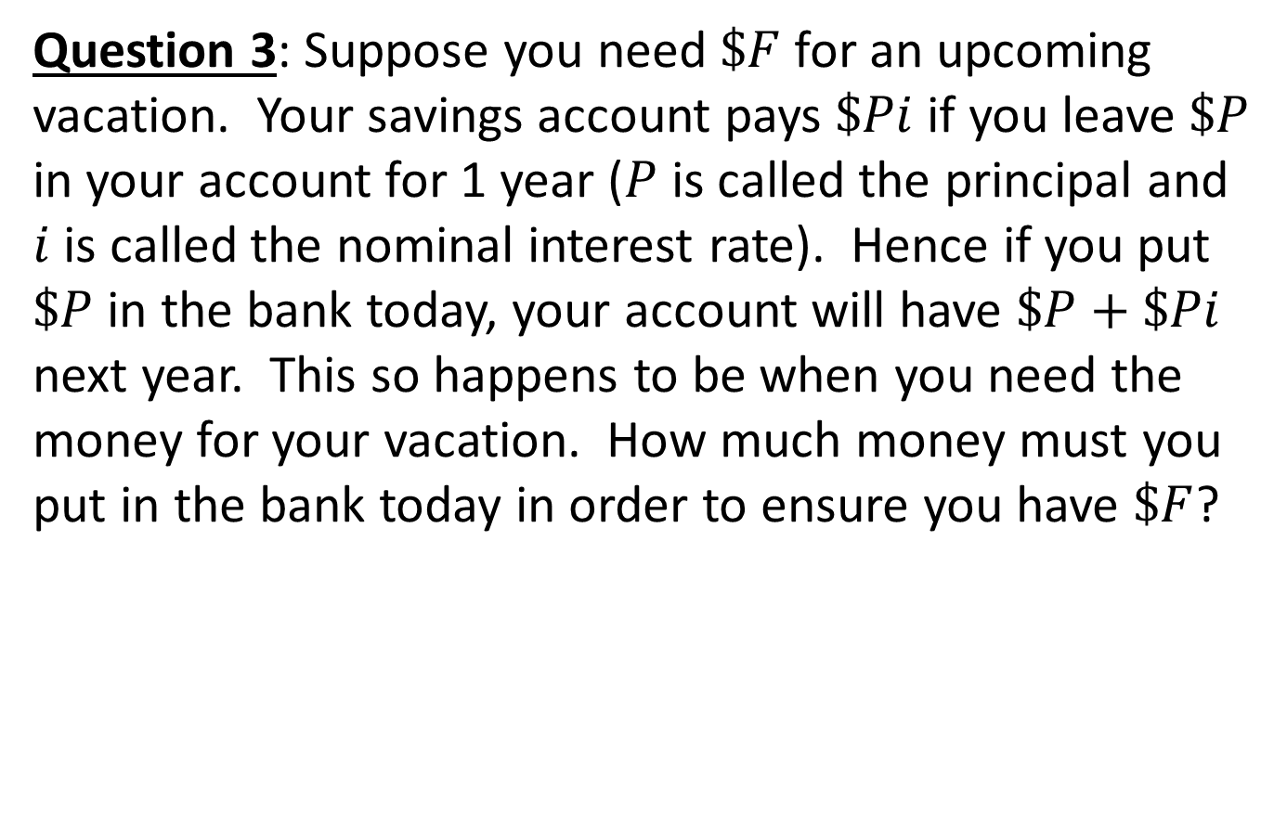
Question 3: Suppose you need $\$F$ for an upcoming vacation. Your savings account pays $\$Pi$ if you leave $\$P$ in your account for 1 year ($P$ is called the principal and $i$ is called the nominal interest rate). Hence if you put $\$P$ in the bank today, your account will have $\$P+\$Pi$ next year. This so happens to be when you need the money for your vacation. How much money must you put in the bank today in order to ensure you have $\$F$?

Slide 18

Solution: What we are looking for is what our initial deposit should be. We know $\$F$ and $i$ (even if they are not given here, those are numbers that can be easily looked up). We want a general equation so our initial deposit can be calculated regardless of those two numbers’ actual quantities. We know we need the following relationship to hold
$F=P+Pi$ (this is called compounding)
So what is $\$P$ (the initial deposit or principal)?
$$F=P+Pi$$
$$F=P\left(1+i\right)$$
$$F∙\frac{1}{1+i}=P\left(1+i\right)∙\frac{1}{1+i}$$
$\frac{F}{1+i}=P$ (this is called discounting)

Slide 19
Question 4:
The height, h, of a woman can be approximated by using the formula h= 3.9r +29. In this formula, r is the length of the radius bone in the forearm and must be measured in inches. Find the approximate height of a woman whose radius bone is r = 10 inches. Express your answer in terms of feet and inches.

Slide 20
To figure out the approximate height, substitute 10 for r and evaluate the resulting expression.
h= 3.9(10) +29 = 68 inches
To write 68 inches in terms of feet and inches, divide 68 by 12 and express the answer as an unreduced mixed number.
68 12= 5 (8/12)
Therefore, 68 inches is equal to 5 ft 8 in.

Slide 21
Question 5: A pharmacist needs to fill an order for a 3% lidocaine topical cream. However, only 2% and 5% concentrations are in stock. How much of the 5% concentration should be mixed with 50 g of the 2% concentration to get a 3% concentration? Check your answer.
Solution:
We are going to let x= the amount of 5% concentration.
The 5% concentration is mixed with the 2% concentration get the 3% concentration, the amount of 3% will be x+50. In other words, the basic equation for this problem is
(amount of 5%) + (amount of 2%) = (amount of 3%)
(x) + (50) = (x+50)
Including the concentrations, the above equation becomes:
    5%(x) + 2%(50) = 3%(x+50)
Rewriting the percent's as decimals:
      0.05x + 0.02(50) = 0.03 (x+50)
Simplifying:
        0.05x + 1 = 0.03x + 1.5

Slide 22
Continuation
Solving for x:
0.05x + 1 = 0.03x + 1.5
Subtracting 0.03x from both sides:
0.02x + 1 = 1.5
Subtracting 1 from both sides:
0.02x = 0.5
Dividing both sides by 0.02 results in:
x= 25
Therefore, the pharmacist must take 25 g of the 5% lidocaine concentration and add it to 50g of the 2% concentration, yielding 75g of a 3% lidocaine blend.

Slide 23
Check
The equation for this problem is
5%(x) + 2%(50) = 3% (x + 50).
5% (25) + 2% (50) = 3% (25 + 50) Substitute x = 25
0.05 (25) + 0.02 (50) = 0.03 (25 + 50) Write percents as decimals
1.25 + 1 = 0.03 (75) Simplify
2.25 = 2.25 Checks

Slide 24
As you have now seen, literal equations do not require a different skill set. One must simply apply the skills he or she already has from learning linear equations to literal equations.
The exercises in the worksheet will help you apply the skills you already possess in linear equations to literal equations.

