Slide 1
Using Ratios and Proportions in Geography, Nursing, Medical and Science Professions
By: Ernesto Garcia and Rebecca Blitzer

Slide 2
Ratio and Proportion Basics

Slide 3
Definitions
Ratio: quantitative relation between two amounts expressed as:
$\frac{a}{b}$, $a:b$, “a to b”
Proportion: name given when two ratios are equivalent expressed as:
$\frac{a}{b}=\frac{c}{d}$ or $a:b=c:d \text{or} ad=bc$

Slide 4
Example
Let’s put an example to these definitions.
Example 1: Let’s suppose, in this room now, there are 20 students and 5 instructors. What is the ratio of students to instructors?
Solution: There are 20 students and 5 instructors, so we would say in this room that there are “20 students to 5 instructors.”

Slide 5
Alternate Forms
We can put that in the other forms of the definition:
$\frac{20}{5}$, $20:5$, “20 students to 5 instructors”
Notice that we have a fraction that we can reduce, $\frac{20}{5}=\frac{4}{1}$. Hence this ratio now becomes “4 students to 1 instructor.” This is also commonly stated “4 students for every 1 instructor.”

Slide 6
Alternate Forms
Proportions are not too different…they are formed using ratios.
If in the room next door there are 40 students and 10 instructors I can say, “the proportion of students to teachers here is equal to the proportion of students to teachers next door.” Put mathematically,
$\frac{20}{5}=\frac{40}{10}$ or $20:5=40:10$

Slide 7
Proportional Forms
For a ratio like 4:1 or 4 to 1, we can always multiply across by a constant and create a new ratio. These two ratios we create will be proportional to each other.
So suppose we multiply 4:1 by 5. We will end up with a ratio of 20:5. Notice that
$\frac{4}{1}=\frac{20}{5}$

Slide 8
Proportional Forms
For our classroom examples we had:
20 students to 5 instructors: multiply 4:1 by 5 and we obtain 20:5 - hence these ratios are proportional.
40 students to 10 instructors: multiply 4:1 by 10 and we obtain 40:10 - hence these ratios are proportional.

Slide 9
Proportional Forms
Another way of checking if ratios are proportional is using cross-multiplication. If we have equality after cross multiplying the ratios then they are proportional:
$\frac{20}{5}=\frac{4}{1}$
$20∙1=4∙5$
$20=20$
$\frac{40}{10}=\frac{4}{1}$
$40∙1=4∙10$
$\text{40 = 40}$

Slide 10
Chemistry

Slide 11
Chemistry: Unit Conversion
Question 1: Using the fact that there are 454 grams in a pound, how many grams are there in 5 pounds?

Slide 12
Chemistry: Unit Conversion
Solution: The ratio of grams to pounds is 454:1. We essentially want to create another ratio of grams to pounds where instead of there being 1 pound like the above ratio, we have 5 pounds.
We can solve this two ways:
Multiply our original ratio by 5:
$$454∙5:1∙5$$
which gives us
$2270:5$
Hence there are 2,270 grams in 5 pounds.

Slide 13
Chemistry: Unit Conversion
Cross multiply:
$$\frac{454}{1}=\frac{x}{5}$$
$$454∙5=x∙1$$
$2,270=x$
$x$ here is the missing value that we are looking for (the number of grams in 5 pounds).

Slide 14
Chemistry: Unit Conversion
Question 2: Every minute a human breathes 10 pints (6 liters) of air into their lungs. How long will it take to breathe in 650 liters of air?
Solution:
$\frac{6 liters}{1min}=\frac{650 liters}{x}$
$6x=650\left(1\right)$
$x=108.33 minutes$

Slide 15
Medicine and Nursing

Slide 16
Medicine: Unit Conversion
Question 3: You are the nurse on duty and a patient’s doctor requests you to administer 1200 mL of some drug over 10 hours. You have to administer the drug using a drip. You put the bag on the drip and the computer governing the drip can be set to administer a certain amount of the solution in the bag per minute. How many drops per minute must be administered to the patient?

Slide 17
Nursing: Unit Conversion
Solution:
The first thing the nurse would need to know or figure out is what the drop factor is. This is how many drops it would take to administer 1 mL of fluid (gtts/mL) or the ratio of drops to 1 mL of fluid.
Since the drip administers the fluid by the drop, you want to know how many drops are required to administer per unit of time or the ratio of drops per minute.

Slide 18
Nursing: Unit Conversion
We know we need to administer 1200 mL in 10 hours. So to solve how many drops will be required per minute, we need to convert hours to minutes which will give us the number of mL needed per minute and in turn the number of drops we need.
$\left(10 hr\right)\left(\frac{60}{1} \frac{min}{hr}\right)=\frac{10∙60}{1}∙\frac{hr∙min}{hr}=600 min$
So we need to administer 1200 mL in 600 minutes or 2 mL per minute or in ratio/proportion form
$\frac{1200 mL}{600 min}=\frac{2}{1}\frac{mL}{min} \text{or}\text{ 1200:600=2:1}$

Slide 19
Nursing: Unit Conversion
A typical IV set is calibrated such that it can deliver 1 mL in 15 drops or a ratio of 1 mL to 15 drops.
We know we need to deliver 2 mL per minute and the IV delivers 1 mL every 15 drops. We need to program the IV to deliver a certain number of drops per minute. So
$2\frac{mL}{min}∙15\frac{drops}{mL}=30\frac{mL∙drops}{min∙mL}=30\frac{drops}{min}$
Put as a product of 2 ratios:
$\frac{Total Volume }{Required Time}\left(\frac{mL}{min}\right)∙Drop Factor\left(\frac{Drops}{mL}\right)=\frac{Drops}{min}$

Slide 20
Geography

Slide 21
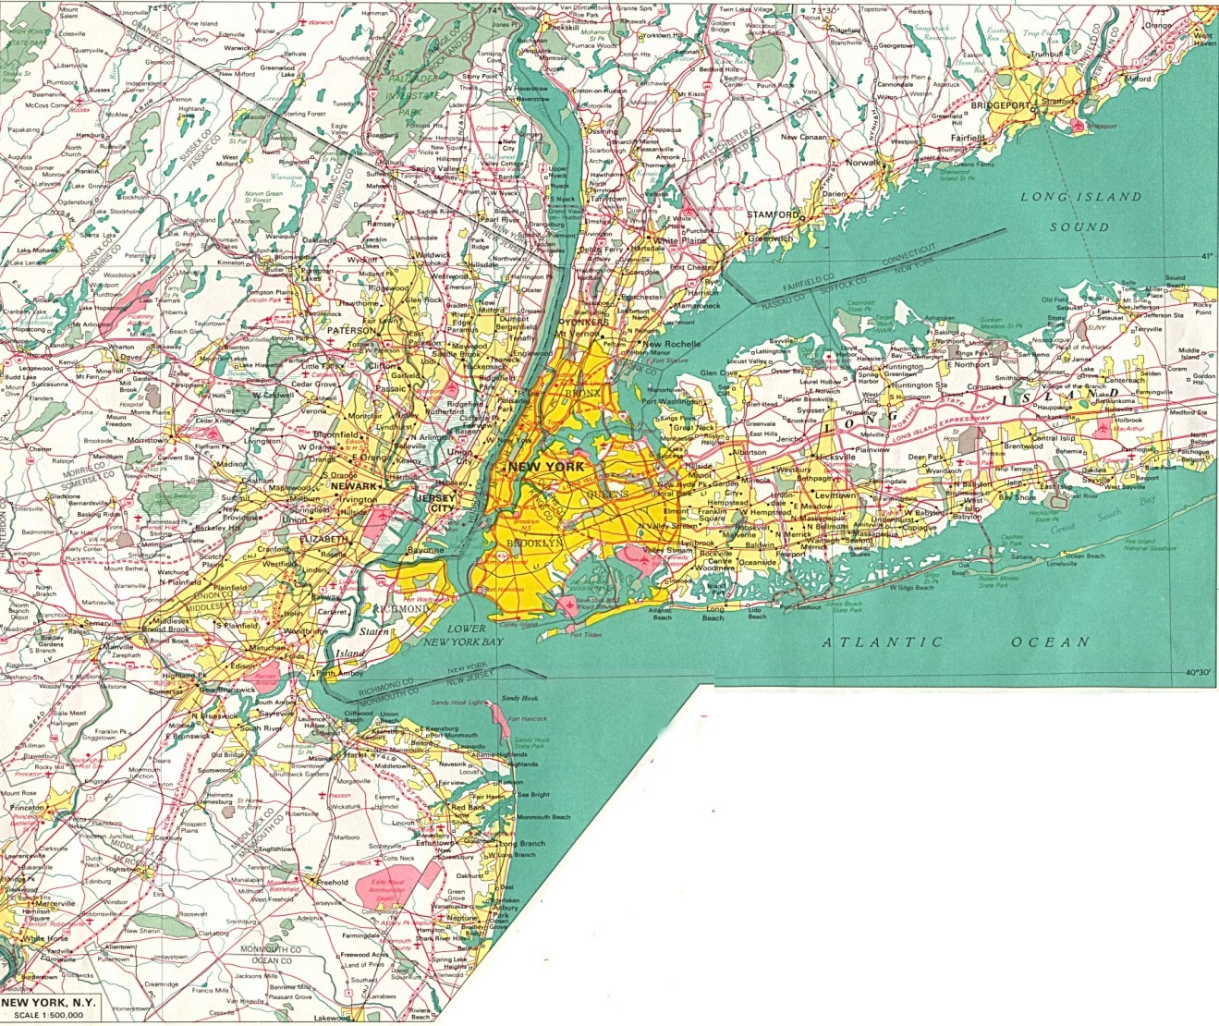
In geography, maps are obviously not drawn in real size. They are scaled versions of the real thing.
A type of map scale that is used is called a ratio scale. On the map on the bottom right it reads 1:500,000.

Slide 22
Geography: Unit Conversion
This means that 1 unit of measure on the map is equal to 500,000 units of measure in real life. So 1 cm on the map would be equal to 500,000 cm in real life and 1 m on the map would be equal 500,000 m is real life.
Question 4: On the map, Newark and Jersey City are about 2 cm away from each other. How far are they from each other in real life in miles?

Slide 23
Geography: Unit Conversion
Solution:
We know that, on the map, Newark and Jersey City are 2 cm away from each other; to find their distance away from each other in real life let’s solve the following proportion
$$\frac{500,000}{1}=\frac{x}{2}$$
In the above proportion, $x$represents real life units in a ratio with what is given (distance on the map).
Cross multiplying:
$$500,000∙2=x∙1$$
$1,000,000=x$
Hence, in real life, Newark is 1,000,000 cm away from Jersey City.

Slide 24
Geography: Unit Conversion
We know that there are 1.60934 km in 1 mile and that there are 100,000 cm in 1 km. So we can convert our cm into km and then our km into miles as follows:
cm to km:
$\frac{100,000}{1}\frac{cm}{km}=\frac{1,000,000}{x} \frac{cm}{km}$
$(100,000∙x)(cm∙km)=1,000,000∙1(cm∙km)$
$$x(km)=\frac{1,000,000}{100,000}\left(\frac{cm∙km}{cm}\right)$$
$x\left(km\right)=10(km)$
So, 1,000,000 cm is equivalent to 10 km.

Slide 25
Geography: Unit Conversion
km to mile:
$\frac{1.60934}{1}\frac{km}{miles}=\frac{10}{x}\frac{km}{miles}$
$$1.60934∙x(km∙miles)=10∙1(km∙miles)$$
$$x(miles)=\frac{10}{1.60934}\left(\frac{km∙miles}{km}\right)$$
$$x(miles)≈6.21(miles)$$
Hence Newark is about 6.21 miles away from Jersey City.

Slide 26
Summary
As you have seen, ratios and proportions pervade many fields of study. We have seen just small subset of the applications of ratios and proportions.
In the worksheet for this workshop, you will get to work out more examples and applications to supplement what you have learned here.

