Slide 1
Precepting dietetic Interns
From Hunter College or other programs
V. Fischer PhD, RDN, CDN
Notes:
This presentation serves as an introduction to precepting Dietetic Interns. It is an introduction. Precepting Dietetic Interns can get as involved as you allow it to be. This presentation will only cover a few critical aspects, based on my experience as DI director and the feedback I have gathered from the Dietetic Interns. For more in-depth information, the CDR offers a free Dietetics Preceptor Training course. You do not have to be an RD to take it. If you are an RD, you can get up to 8 CEU credits.
The examples used in this presentation are for the Hunter programs than include supervised practice experience.

Slide 2
Overview
Foundation of supervised practice experience toward the RDN credential
Desired outcomes: Competence defined by competencies
Planning & Structuring the experience: rotations in different arrangements
Building competence
Expectations
Evaluations
Facing challenges
Notes:
These are the topics we will touch upon:
Foundation of supervised practice experience toward the RDN credential
Desired outcomes: Competence defined by competencies
Planning & Structuring the experience: rotations in different arrangements
Building competence
Basics at your facility
Reflective practice
Expectations
What can interns do?
What should interns be able to do coming in?
How much time does precepting cost?
Evaluations
Facing challenges
Perceived motivation
Preparation
Questions from interns
Professionalism
Communication

Slide 3
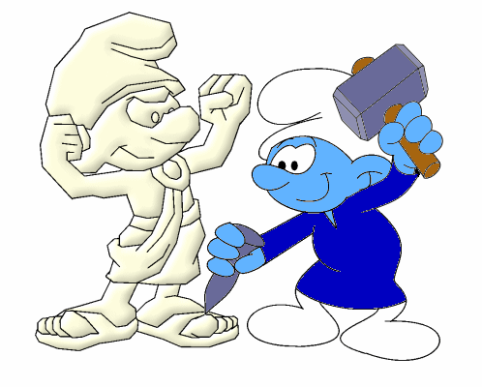
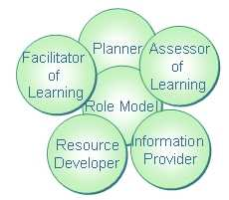
Foundation: supervised practice experience
You shape your future coworkers, and with that, the future of our profession!
https://vignette.wikia.nocookie.net/smurfsfanon/images/9/9b/Sculptor_Working.gif/revision/latest?cb=20120601213838
Notes:
Preceptors shape future RDNs
Plan the experience
Model RDN behavior on all levels
Teach
Provide information,
facilitate learning,
develop resources
Assess learning
CDR Preceptor Training Course, Module 1, http://www.cdrcampus.com/course/view.php?id=131&page=1545 , 6/10/18
These are hallmarks of successful preceptors:
Are organized and focused
Value preceptor-student interactions
Are dynamic and enthusiastic
Relate well to students
Use an analytical approach
Are competent and confident
Model professional behavior
(CDR Preceptor Training Course, Module 1, 6/10/18)

Slide 4
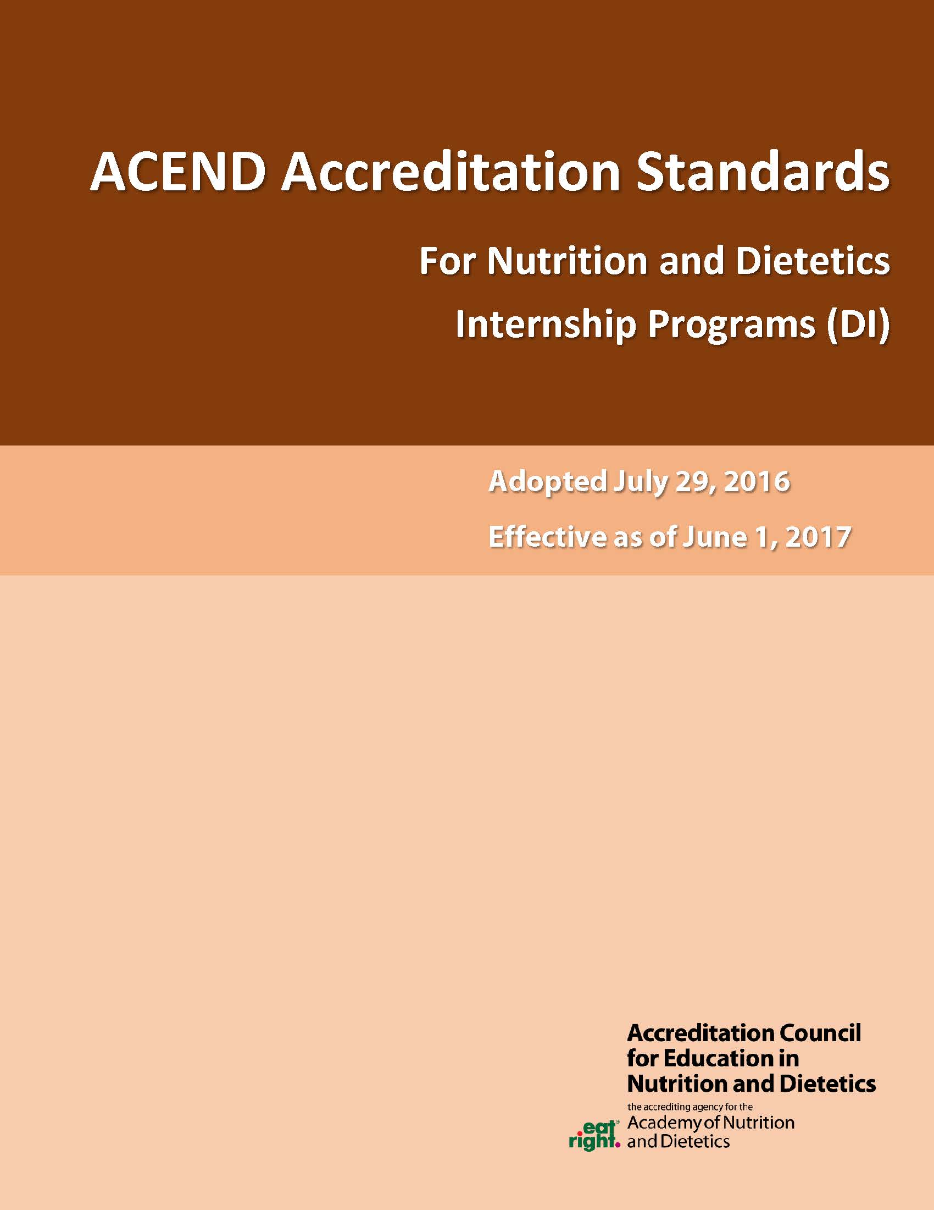
Foundation of supervised practice experience toward the RDN credential:
ACEND-defined competencies
ACEND: Accreditation Council for Education in Nutrition and Dietetic
https://www.eatrightpro.org/acend/accredited-programs/about-accredited-programs
Competencies
Performance Indicators
Notes:
ACEND: Accreditation Council for Education in Nutrition and Dietetic
https://www.eatrightpro.org/acend/accredited-programs/about-accredited-programs
Sets Standards that must be met in order to become eligible for the RD exam
Including definition of what a student must be able to do to graduate,
Detailed into either competencies or further into performance indicators
Accredited, in turn, by the US Department of Education
Must comply with the USDE standards
For 2017 Standards: https://www.eatrightpro.org/acend/accreditation-standards-fees-and-policies/2017-standards , see appendix A of the standards document
For FEMG Standards: https://www.eatrightpro.org/acend/accreditation-standards-fees-and-policies/future-education-model
“ACEND Competencies Statements specify what every dietitian should be able to do at the beginning of his or her practice career. The outcome statements build on appropriate knowledge necessary for the entry-level practitioner to perform reliably as either a RD or a DTR respectively. These are usually met during a supervised practice program, either integrated with an academic degree program or as an independent program.” CDR Preceptor Training course Module 2, 6/10/18

Slide 5
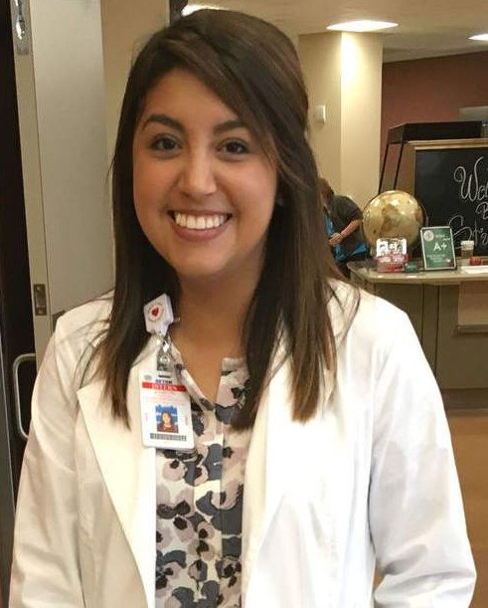
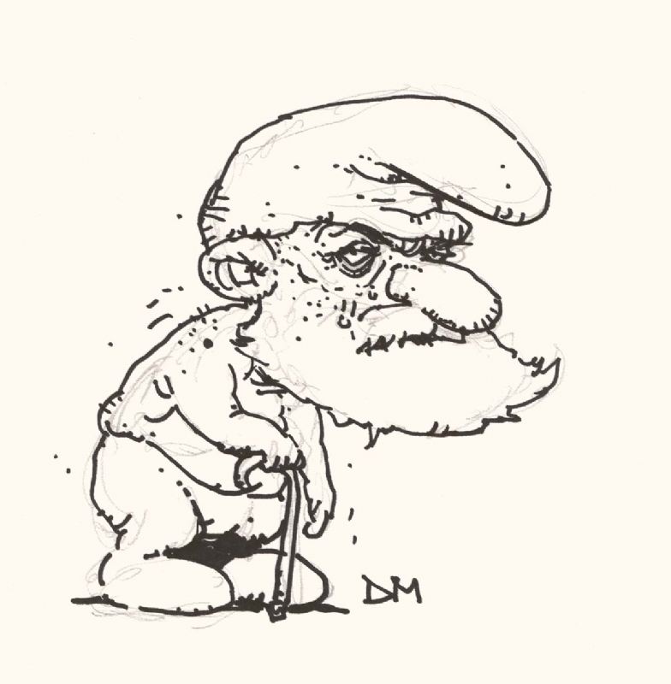
Competencies
Site specific
All sites
3 journal articles support this, EAL says imperative
I have brought a brochure you can take home.
Scientific and Evidence Base of Practice
Clinical and Customer Services
And how did you like the beans at lunch today?
Practice Management and use of resources: Quality Assurance etc.
Dietetic intern
Professional Practice Expectations: beliefs, values, attitudes, behaviors
It’s MR. SMURF, not Theodore
http://www.txstate.edu/cache0ba50e8f14f05f0196b00fe31b6592fc/imagehandler/scaler/gato-docs.its.txstate.edu/jcr:1d360292-ea8a-4811-8229-f7e1ff2d5eae/juliette%2Bhorizontal.jpg?mode=clip&width=1093&height=615
http://art.cafimg.com/images/Category_8401/subcat_15887/Mahnke.jpg
Theo Smurf
Notes:
All sites: repeated
Scientific and Evidence Base of Practice
Integration of scientific information and research into practice
Scientific evidence as basis for programs, products, services and care
E.g. background for MNT, data supporting use of a cooking method
Students can do a literature review to provide references & a summary
Check references for propriety
Professional Practice Expectations: beliefs, values, attitudes and behaviors
Many of them need to be reflected upon – talk about them!
Site specific – unique:
Clinical and Customer Services
Development and delivery of information, products and services
Communication skills: oral, print, visual, electronic – social media
Practice Management and use of resources
Feasability studies, Quality assurance, Quality improvement

Slide 6
Hunter Programs – Striving for Efficiency
Learning is much more efficient hands-on!
Integrated Programs: Closer cooperation between facilities and program
  Via students and direct communication
http://www.danielwillingham.com/uploads/5/0/0/7/5007325/2882821_orig.png
Notes:
Traditional Dietetic Internship
Students have completed their academic coursework
Expected to have the background for entry-level work
Need to learn the practical application of the theory
Learning is much more efficient hands-on!
Integrated Program in Nutrition and Dietetics: IPND
Students have completed a part of their academic coursework
Expected to have the resources and basic background
Need to learn in-depth theory and practical application together
Closer cooperation between facilities and program
Via students and direct communication

Slide 7
Competency-based Learning
Learn until you can do it
Then move to the next learning step
Targeted Evaluation of Performance Indicators
  Observation
  Interviews
  Surveys of patients/clients
  Other team members
Already done for physicians, nurses, PT, OT
The goal
&
Your role
Does
Performance integrated into practice
Shows
Demonstrates
Knows
Fact gathering
Notes:
Traditional Dietetic Internship
Students have completed their academic coursework
Expected to have the background for entry-level work
Need to learn the practical application of the theory
Learning is much more efficient hands-on!
Integrated Program in Nutrition and Dietetics: IPND
Students have completed a part of their academic coursework
Expected to have the resources and basic background
Need to learn in-depth theory and practical application together
Closer cooperation between facilities and program
Via students and direct communication

Slide 8
Hunter Programs – The Future is here!
Traditional Dietetic Internship
  Students have completed their academic coursework
Integrated Program in Nutrition and Dietetics: IPND
  Students have completed the relevant part of their academic coursework
Closer cooperation between facilities and program
  Via students and direct communication
Notes:
Traditional Dietetic Internship
Students have completed their academic coursework
Expected to have the background for entry-level work
Need to learn the practical application of the theory
Learning is much more efficient hands-on!
Integrated Program in Nutrition and Dietetics: IPND
Students have completed a part of their academic coursework
Expected to have the resources and basic background
Need to learn in-depth theory and practical application together
Closer cooperation between facilities and program
Via students and direct communication

Slide 9
Building competence

Slide 10
Most important step:
Planning and Structuring
Develop a plan for activities / tasks / responsibilities of the intern
Communicate that plan on day 1, and at least weekly thereafter.
Plan
2/30/19
Screen new admits
Gather assessment data for 3rd floor
Redesign HTN hand-out
Notes:
Develop a plan for activities / tasks / responsibilities of the intern
Communicate that plan on day 1, and at least weekly thereafter.
Communicate your expectations clearly.
Communicate limits clearly, to all involved.
E.g. don’t enter anything into the EHR until approved.
E.g. communicate expectations, limits & student abilities to RDs who “take” the student for the day.
If delegating to other RDs, communicate expectations on their workload, too.
Check in frequently if expectations are met and re-evaluate expectations and plan.
Uncertainties yield errors and decreased productivity.
Clear expectations allow students to take initiative to excel.

Slide 11
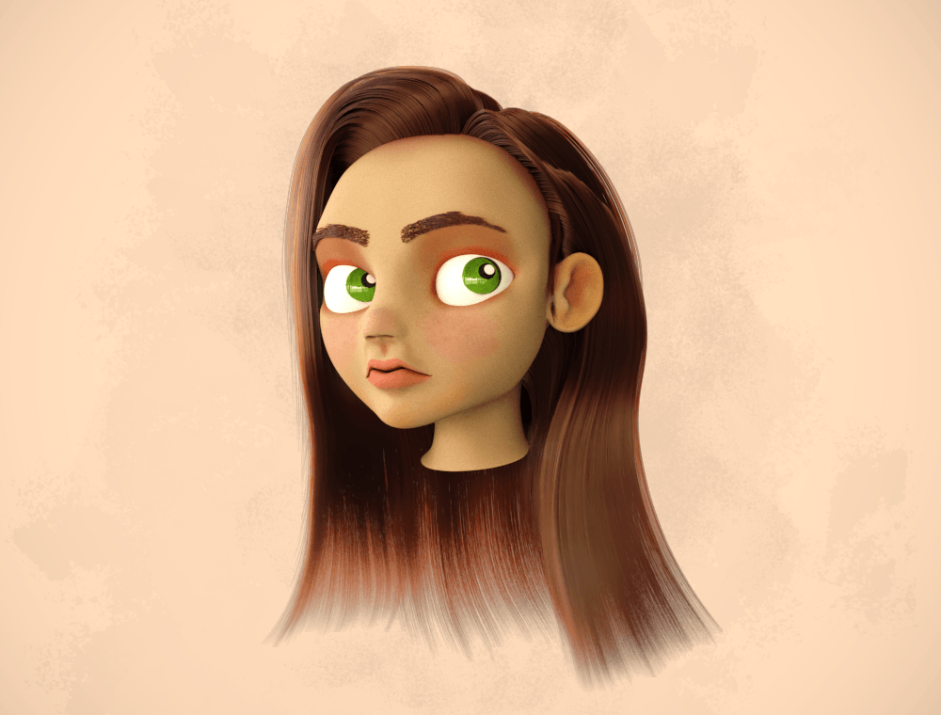
If you don’t know where you are going, don’t be surprised if you don’t get there.
What am I going to actually say?
I’ve been reading this for 2 hrs, still don’t know…
Ht, Wt → BMI
HTN → DASH diet
Planning is key to success
Plan with the DI / IPND program:
  Where do the students need to go?
  Where are the students coming from?
I can’t ask another question!
Losartan?
What is AKI again?
This person is really old!
Na 130mg/dL – do I need to look that up?
https://3dexport.com/items/2017/04/13/446502/190960/girl_head_free_3d_model_c4d_max_obj_fbx_ma_lwo_3ds_3dm_stl_2023404_o.png

Slide 12
Planning the experience
Onboarding: what are relevant policies at your facility
  Often takes 8 weeks plus for paperwork
Orientation
  To the facility
    Policies and procedures – confidentiality
    Mission and goals of the program / department / facility
    Org chart / introduction to relevant personnel
      Names in writing
    Physical orientation to the facility – where are relevant rooms
      Can be overwhelming
    → create an atmosphere conducive to learning – away from “drama”
What (tasks) should the intern be able to perform at the end?
  Entry level competency
  Job description of entry-level RDN at your facility can help
  Cross-check with list of competencies from the program
Setting the stage
Tip: CDR has a checklist (module 2 of their course)
Writing the playbook
Notes:
Define what you want the student to be able to do (competencies).
What will the student need to start?
Can you define a sequence of tasks (really: competencies) growing more and more complex toward each competency?
What competencies does the student need for a specific task?
E.g. meal rounds – must know what is allowed on the pt’s diet
Easier task: check meal tickets (with enough time to look up every item they are unsure about)
Preparation: Review menu, review menu item characteristics/analysis
Guidance: e.g. task the student to identify the items highest/lowest in sat. fat/sodium/etc.
E.g. nutrition assessment – preparation of conversation with patient: must know all diseases, interpret labs, understand all pertinent history and identify potential problems – checkpoint!

Slide 13
Desired Outcome: Competence
Define what you want the student to be able to do (competencies).
What will the student need to start?
Can you define a sequence of tasks (really: competencies) growing more and more complex toward each competency?
What competencies does the student need for a specific task?
  E.g. meal rounds – must know what is allowed on the pt’s diet
    Easier task: check meal tickets (with enough time to look up every item they are unsure about)
    Preparation: Review menu, review menu item characteristics/analysis
      Guidance: e.g. task the student to identify the items highest/lowest in sat. fat/sodium/etc.
  E.g. nutrition assessment – preparation of conversation with patient: must know all diseases, interpret labs, understand all pertinent history and identify potential problems – checkpoint!

Slide 14
Your turn
Take 5 minutes to start completing the following table:
What do RDs do at your facility?
Tasks | Required competencies | (leave blank for now)

Slide 15
Tasks | Required competencies | (blank)

Slide 16
Step by step planning
Tasks broken down into separate competencies:
Tasks | Required competencies
Pt assessment | Finding information in chart
 | Collecting info in meaningful form
 | Interpreting data: dominating diseases, lab values – possible causes for anomalies, Rx – food-drug interactions & effect on GI function
 | Synthesizing into nutrition Dx, etc.
Translate into ACEND competencies 3.1
Notes:
Example: Hgb/Hct: micronutrient deficiency Fe vs. folate, B12 vs. copper; anemia of chronic disease, anemia due to blood loss, anemia due to erythropoietin deficiency in renal disease
Rx: Coumadin, MAOIs, chemotherapy; albuterol makes shaky – no broth when at home?

Slide 17
Planning the experience for a specific goal
Define what you want the student to be able to do.
What will the student need to learn (learning goals)?
  e.g. Nutrition Assessment using an ADIME format
What will the student need to start?
  Individualized vs. generalized plan
  E.g. policies/procedures, knowledge/skills
  E.g. determining which patients need assessment – student needs to know about screening, needs to know what screening tool is used / by whom/ how communicated/where to find, needs to know triage algorithm
What will you do to help the student reach this goal (teaching goals)?
E.g. have student review Nutrition Care Manual for cardiac diseases before going on cardiac ward
Have student prepare assessment on paper and write out questions on the patient, with sample consequences of answers
Review the case before & after Pt interview, discuss potential interventions
Does
Shows
Knows

Slide 18
Building experience
Care plan meeting
Schedule change
Organize meeting with ….
Medical terminology and acronyms
Pt’s cultural background
Puzzle pieces
Current MNT recommendations
Get back to pt X
Presentation on…
Menu & options
Etc.
FSM software
EHR software
Chart note
Etc.
Roles of other health care team members
Interpretation of lab values
Menu changes
Food-Medication Interactions
Nutrition-focused physical exam
Notes:
Students come in with fact knowledge of separate items. Depending on factors like the program, and the student’s situation in the course where an item was taught, they have more or less knowledge of an item.
They only know these topics in the context of academia and theoretical application in case studies.
They need to
Remember all those details, specific to the patient they are treating,
Integrate all the details to see the nutrition problems, appropriate goals and according interventions,
In a very limited period of time.

Slide 19
Sample sequence for a clinical rotation
Week 1: P&P manual, any available meetings, meal rounds, shadowing RD, gathering data for assessment, suggesting DIME, then completing with RD; possibly starting on a specific project if planned (e.g. CQA/CQI, preparing a presentation
Week 2: first assessments & follow-ups under close supervision: discuss before and after visit with patient, discuss draft, read before signing off. Make sure proper resources are used.
Week 3-6: number of assessments & follow-ups should increase to about 50% of normal work load, with decreasing need for guidance and correction. Different floors & different RDs, as applicable, to learn different styles. Decide on project if not done. Decide on presentation.
Weeks 7-8: further increase in work completed, Nutrition support and more complex patients. Encourage questions strongly. Keep challenging the student.
Weeks 9-12: allow/require more independence as you see the student’s abilities grow.

Slide 20
Disease groups*
Introductory Rotations
Behavioral Health
Gastrointestinal Disorders
Cardiovascular Disease, Metabolic Syndrome and Obesity
Diabetes
Neurological Disorders / Dementia
Advanced Rotations
Pediatrics
Renal Disease
Oncology
HIV/AIDS
Nutrition Support
Age groups
Infants
Children
Adolescents
Adults
Older adults
Pregnant/lactating women**
Some disease groups may not occur in your facility. They can be covered differently by the program.
** not really an age group, but definitely not a disease, either

Slide 21
Projects for clinical rotation (Hunter specific)
Case descriptions: at least 5; 10 disease groups must be covered
  Etiology, pathophysiology
  Current MNT recommendations
  Description of the patient (HIPAA compliant): assessment with all ADIME steps, includes PES statements
  Analysis of labs: possible causes for their anomaly
  Analysis of Rx: purpose, food-Rx interactions, effect on GI tract and absorption of nutrients
Knowing the regulating agencies
Optional: Service Improvement Project
  Can be CQI/CQA, must include data gathering and analysis

Slide 22
What should the intern be able to do coming in?
Take 5 minutes to start completing the following table:
What should the intern be able to do before coming in?
Learning goal | Required competencies | Resources for review
 | MNT for ASCVD | NCM, textbooks?
A definite list of prerequisites helps the intern prepare for the rotation with you.

Slide 23
What should the intern be able to do coming in?
http://beyondrecognition.net/wp-content/uploads/2015/05/Elephant_wBlindment_Fx600.png
Clear expectations help make the rotation successful and low stress for all.
Give the intern time to review in the beginning, and possibly in-between, to prepare
  E.g. before going on a new specialized floor – review cardiac diseases before going on the cardiac floor
  E.g. before going to a Head Start program – review CACFP regulations
Be realistic – students are still learning
Input required!
  Nothing that is normal and goes without saying for you does so for students.
Your input predetermines output, as one critical factor.

Slide 24
SMART goals
Phrasing goals well allows
  Structured experience
  Clear expectations and goals
  Measurable progress
Example: pt care on cardiac floor (time frames vary with student’s prior experience)
Within 2 weeks, the student will
  collect pt data from the chart in a structured fashion,
  Interpret lab values with respect to likely causes,
  Analyze the patient’s intake and GI status with respect to possible impact of drug regimen,
  Calculate the patient’s estimated requirements,
  Suggest a list of the patient’s nutrition problems
  for 4 patients per day.
Within 2 weeks, the student will perform Nutrition-focused physical exams on patients per facility policies, on all patients seen.
Within 3 weeks, the student will perform 4 assessments per day for patients with cardiac diseases as their predominant disease on non-critical floors.

Slide 25
Logistics: Who will be responsible for which part?
Take 5 minutes to start completing the following table:
What should the intern be able to do before coming in?
Learning goal | Experience for learning | Responsible to facilitate
Pt care Cardiac floor | Assessments & F/U cardiac floor | RDN covering cardiac floor
A definite list of prerequisites helps the intern prepare for the rotation with you.

Slide 26
The Competencies
Scientific and Evidence Base of Practice
  Integration of scientific information and research into practice
  Scientific evidence as basis for programs, products, services and care
    E.g. background for MNT, data supporting use of a cooking method
    Students can do a literature review to provide references & a summary
    Check references for propriety
Professional Practice Expectations: beliefs, values, attitudes and behaviors
  Many of them need to be reflected upon – talk about them!
Clinical and Customer Services
  Development and delivery of information, products and services
  Communication skills: oral, print, visual, electronic – social media
Practice Management and use of resources
  Feasabiity studies, Quality assurance, Quality improvement
All sites – repeated
BLACK print
Site specific – unique
COLORED print

Slide 27
Hunter Programs: Traditional Dietetic Internship Program
Rotation description includes
Competencies
Projects for the student to complete
Color code for typical distribution (electronic file)

Slide 28
Step by step planning
Tasks broken down into separate competencies:
Tasks | Required competencies
Pt assessment | Finding information in chart
 | Collecting info in meaningful form
 | Interpreting data: dominating diseases, lab values – possible causes for anomalies, Rx – food-drug interactions & effect on GI function
 | Synthesizing into nutrition Dx, etc.
Notes:
Example: Hgb/Hct: micronutrient deficiency Fe vs. folate, B12 vs. copper; anemia of chronic disease, anemia due to blood loss, anemia due to erythropoietin deficiency in renal disease
Rx: Coumadin, MAOIs, chemotherapy; albuterol makes shaky – no broth when at home?

Slide 29
Step by step planning
Tasks broken down into separate competencies:
Tasks | Required competencies | Preparation | Learning activity | Learning control
Pt assessment | Collecting info in meaningful form | Ensure student has template | Retrieve info with students, then student collects info | Review results until results reliable
De-brief: This is where learning happens. We learn from mistakes and imperfections.
Stress prevents learning → positive messaging.
Notes:
Example: Hgb/Hct: micronutrient deficiency Fe vs. folate, B12 vs. copper; anemia of chronic disease, anemia due to blood loss, anemia due to erythropoietin deficiency in renal disease
Rx: Coumadin, MAOIs, chemotherapy; albuterol makes shaky – no broth when at home?

Slide 30
Summary Planning
Tasks | Required competencies | Resources for review | Experience for learning | Responsible to facilitate
Pt care Cardiac floor | MNT for ASCVD | NCM, textbooks? | Assessments & F/U cardiac floor | RDN covering cardiac floor
Other aspects: How will you gradually increase the student’s responsibilities?
Communication and evaluation of progress

Slide 31
Expectations
What can interns do?

Slide 32
The ultimate goal: Staff relief
From the start
  Students should be able to find information in the literature
    Textbook is minimum and only a starting point
    AND resources should be expected
    Research literature second semester of MS and up
End of rotation: entry-level competence
  Students should be able to perform all duties of an entry-level RD
Staff relief: a balancing act
  Students shall not routinely replace employees (ACEND)
  Students should achieve entry-level competence (ultimate goal of DI and IPND programs)

Slide 33
What does precepting cost?
Cost | Benefit
Organization of administrative details | Personal gain of competence Including HR management
Planning of experience | Influence on future RDNs Including pre-trained new employees
Time for daily explanations and reviews | CEUs (up to 3 per year)
 | Observation of growth

Slide 34
Facing challenges
Notes:
Perceived motivation
Preparation
Questions from interns
Professionalism
Communication

Slide 35
Nobody is perfect
Expect the unexpected – in both directions!
  Many students in the DI programs have extensive volunteer experience
  Some have research experience and/or professional experience
  Use the students’ prior experience!
Different learning styles
Different experiential background
  Success strategies
  Professional experience – degree of independence
  Performance orientation
Different cultural background → different responses
Different knowledge background
} Communicate!
Communicate!
Communicate!
Picture of miscommunication
Or
Group of animals
Notes:
Learning styles: visual – auditory – kinesthetic
Experiential background: so far, students have achieved their goals by? Book knowledge, hard work, figuring out ahead of time what the test questions would likely be, what points are given for,
Student’s emphasis is on best possible patient care, high number of assessments, just completing the requirements, pleasing you as preceptor, doing things their way, showing off what they have learned rather than being open to what they can learn (insecurity!)
Cultura

Slide 36
Evaluation: Continued Assessment
Take notes of strengths and weaknesses
Communicate weaknesses – focus on what you want the student to do differently:
  How could you get this information in a more orderly/structured fashion?
  To keep the information more structured, I usually … / I used to … in the beginning
  I suggest you do it this way next time: ...
Summarize at the end of the day
  Let the student to that work
    Control that your messages arrived
  Cross-check with your notes
  Be specific in examples
    “always” and “never” are hurtful.
    Positive messages yield better results
  Spend a few minutes thinking about the best way to move forward.
Collect your notes
  to remind yourself of progress
  To communicate with others involved with the student

Slide 37
Evaluations
Assessment of competency
  Along the way to allow the student to focus their efforts
  Comprehensive mid-rotation evaluation
    All applicable competencies
    1= appropriate progress, 0=insufficient progress
    Discussed with the student
    Submitted to the program
  Comprehensive end-rotation evaluation
    Defines pass/fail of student: minimum “pass”: 3 = Beginner
    Desired level: 4: competent

Slide 38
Evaluations: Levels of performance
1: Unprepared. Unable to complete assignments, and/or Fund of knowledge inadequate
2: Novice. Requires considerable support and oversight. Skills need significant development.
3: Beginner: Applies knowledge appropriately with some support and oversight. Developing skills are evident.
4: Competent: Requires minimal oversight. Demonstrates sound knowledge and application skills.
5: Expert: Functions independently in staff relief capacity. Demonstrates advanced level knowledge and skills.
N/A: Not applicable, no opportunity to evaluate

Slide 39
Evaluations
Professionalism

Slide 40
Evaluations
Future Education Model ideals: evaluation of competencies with specific test tools
To be found on our program website
http://www.hunter.cuny.edu/nutrition/dietetic-internship/dietetic-internship-program-1
(link in my address in emails)
Preceptor resources tab
Coming later in August, and evolving thereafter

Slide 41
Evaluations
Comp. No. | Criteria/Performance Indicator | Below expectations |  |  | Met expectations |  |  |  | Exceeded expectations |  |  | Not observed | Comments
7.1 | Assumes professional responsibilities to provide safe, ethical and effective nutrition services
 | Demonstrates cultural, gender and racial sensitivity; strives to achieve cultural competence. | 1 | 2 | 3 |  | 4 | 5 | 6 | 7 | 8 | 9
 | Demonstrates understanding regarding beliefs, values, attitudes and behaviors to support nutrition education and contribute to team-based care. | 1 | 2 | 3 |  | 4 | 5 | 6 | 7 | 8 | 9
 | Patient interaction: well-organized, good patient rapport, appropriately addresses questions and concerns; demonstrate cultural sensitivity | 1 | 2 | 3 |  | 4 | 5 | 6 | 7 | 8 | 9
 | Appropriately creates/adapts educational materials to address individual needs (i.e. age, cultural, literacy) | 1 | 2 | 3 |  | 4 | 5 | 6 | 7 | 8 | 9
 | Complies with standards, regulations, scope of professional dietetics practice and Code of Ethics. | 1 | 2 | 3 |  | 4 | 5 | 6 | 7 | 8 | 9
 | Maintains patient confidentiality at all times. Adheres host facility policies and procedures | 1 | 2 | 3 |  | 4 | 5 | 6 | 7 | 8 | 9
 | Performs self-assessment; develops goals; takes responsibility for own learning. | 1 | 2 | 3 |  | 4 | 5 | 6 | 7 | 8 | 9

Slide 42
Underperforming students
Ask why the task was performed this particular way
  I see that you have not calculated the patient’s estimated energy requirement. What was the reason to leave this out? Or: What will you do to make sure that you don’t forget this again?
  I see that you have worked with a lot of publications directed at laypersons. What was the reason for using these sources? How did you check that the information in those sources was accurate?
Explain which aspects of the task are done,
Explain which tasks still need to be done, for you to be able to use the work.
Indicate resources
Provide a time frame for revision or new task
Take notes of this, along with notes of achievements.
Most frequently, not communicating leads to failure and frustration for all involved.

Slide 43
Underperforming students: Analyzing the cause
Lack of experience in applying theory to practice
Inadequate knowledge
Poor comprehension (language barriers)
Poor time management / organizational skills
Fatigue, stress, work overload
Low self-esteem (or too much!), insecurities
Discomfort with work situation (patients/clients, atmosphere)
Rare: poor attitude
All of these become clear in communication, 1-5 easier than the rest.
Tip: CDR has a list of problems & remedies (module 3: Barriers, of their course)

Slide 44
Consistently underperforming students
If you find the students is consistently underperforming
1. speak with the student to identify causes
  Most frequently, the student is not clear on expectations or is not using appropriate resources
2. speak with the program director
  Most frequently, poor performance is consistent across rotations
  Most frequently, a plan for successful remediation can be developed
    And maybe sometimes, the profession is better served if the student is advised out of this line of work???
Most frequently, not communicating leads to failure and frustration for all involved.

Slide 45
Motivation and preparation
Perception
Causes:
Clear expectations missing
Goals not synchronized – purpose of tasks not clear
Notes:
Perceived motivation and preparation
Some students seem demotivated.
List 3 reasons for being unmotivated.
Expected answers: clinical rotation for a community student, tired, overworked, distracted by other obligations
Remedy:
Ask why the student seems demotivated.
This tells the student that their current attitude is not conducive to a good experience. If they don’t correct immediately, tell them that you don’t like teaching someone who is not interested.
Ask what interests the student about the task ahead (don’t ask if they are interested. Example; are you interested in peeling potatoes? No. But when I ask you what interests you most about peeling potatoes, what will you say? Raise your hand if you just thought about the process of peeling potatoes in your mind. I made you think about the task ahead and made you try to find something interesting about it. The answer may still be “I don’t know”, but they have thought about the task.
The better you know the student, the better your question can be. 5 minutes of thinking ahead what you want the student to learn to do will increase your success exponentially, and then both you and the student are happy. The student learns faster, and then can be as productive as students can be, sooner.
Preparation
You ask the student a question the answer to which you find basic. The student doesn’t know.
Possible reasons:
The student did not prepare.
Provide resources to prepare. Provide realistic time frame to prepare. Test if prepared at the agreed time.
The answer really is specialized, you have become used to knowing this because it’s part of your work.

Slide 46
Assessment of the intern
Goals for the rotation
  Hunter: students set goals for each rotation. Review with student.
Learning progress
  Weekly log includes competencies. Review with student weekly.
  Provide time for student to prepare / reflect upon
  Portfolio: materials documenting achievements should grow weekly.
  Provide time for student to work on.
Checklists and Rubrics
  Especially for the IPND program:
  Rubrics for competencies will be provided on the Preceptor resources webpage

Slide 47
Questions from interns
If appropriate:
Answer a question with a question that guides the student to apply their knowledge to answer the question.
Make sure your question is open-ended:
  What do you know about the patient that is relevant for this decision?
  You know she isn’t eating enough so why would you think that a more restrictive diet could be better?
This will tell you where the knowledge gap lies.
It will encourage the student to think about the issue before asking.
It will encourage the student to gather evidence for their suggested solution.

Slide 48
Questions from interns
If you don’t know the answer:
As appropriate:
Have the student look it up and report back, with references
Indicate resources if possible
Provide time.
  This is difficult for performance-oriented students

Slide 49
Questions from interns: Guide to Critical Thinking

Slide 50
Professionalism
Appearance
Multiple aspects reflecting values directed toward high quality service to others, e.g.
Responsibility
Dependability
Accountability
Respect
Compassion
perseverance
Appropriate Attitude:
  Courteous
  Respectful
  Open to learning
  Engaged
  Proactive
  Positively resourceful
  Going the extra mile

Slide 51
Communications
Define preferred way and frequency of communication
  In-person, email, phone
  After every patient encounter / daily / weekly
  This can change during the rotation!
Allow enough time for communication
Ascertain that communication was effective
  Did your message arrive? Did you receive the student’s message?
Communicate with the program
  Before, in the middle and at the end of the rotation
  As soon as concerns arise, no matter when

Slide 52
Most important step:
Planning and Structuring
Evaluate and re-evaluate
Develop a plan for activities / tasks / responsibilities of the intern
Communicate that plan on day 1, and at least weekly thereafter.
Communicate your expectations clearly.
Communicate limits clearly, to all involved.
  E.g. don’t enter anything into the EHR until approved.
  E.g. communicate expectations, limits & student abilities to RDs who “take” the student for the day.
  If delegating to other RDs, communicate expectations on their workload, too.
Check in frequently if expectations are met and re-evaluate expectations and plan.
Uncertainties yield errors and decreased productivity.
Clear expectations allow students to take initiative to excel.

Slide 53
Resources
CDR Dietetics Preceptor Training Program
NDEP Line article summer 2018

Slide 54
Thank you!

